Slide 1
Report 06/15/2020
P. Hacker

Slide 2
Previously: Geometry Sensitivity Study
prime radiation feedback controlled discharge 20181010.032 exhibits transitions from attached to detached states and back (90%-100% radiation fraction)
calculate STRAHL radiation profiles with given electron temperature and density at distinct radiation fraction levels to investigate intrinsic (oxygen and carbon) impurity radiation
STRAHL profiles show asymmetric chordal profiles after forward calculation with emissivity matrices, though being symmetric

Slide 3
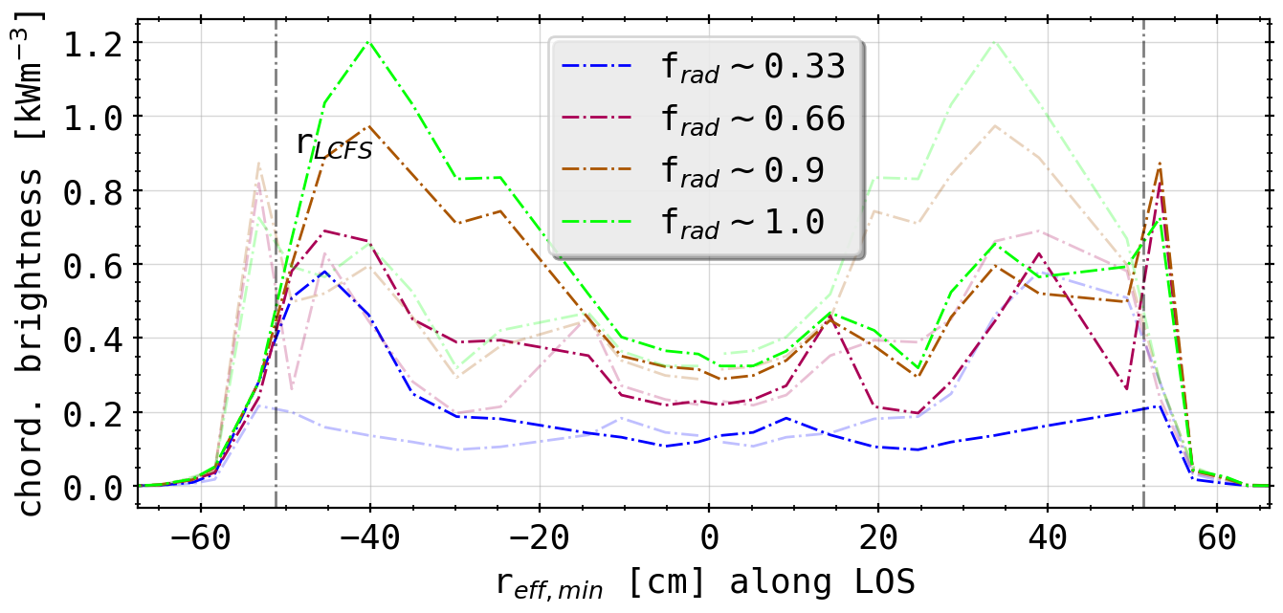
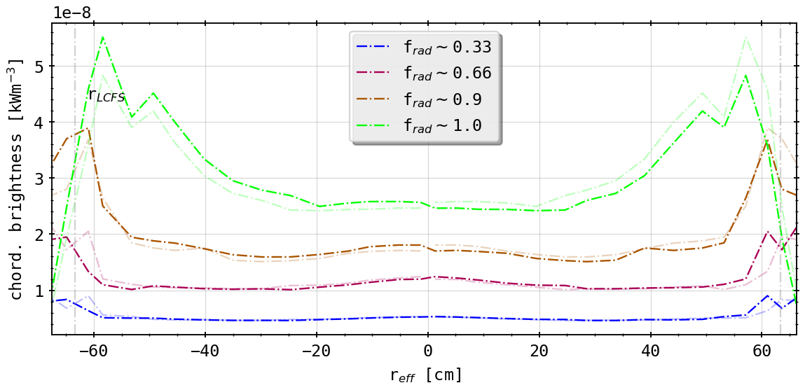
Previously: Geometry Sensitivity Study
STRAHL profiles show asymmetric chordal profiles after forward calculation with emissivity matrices, though being symmetric
(chordal profile 20181010.032, HBCm)
(chordal profile HBCm from STRAHL)

Slide 4
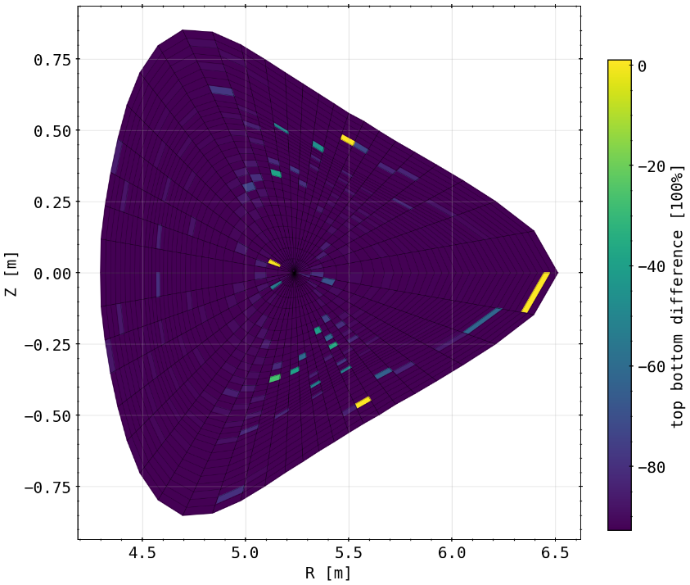
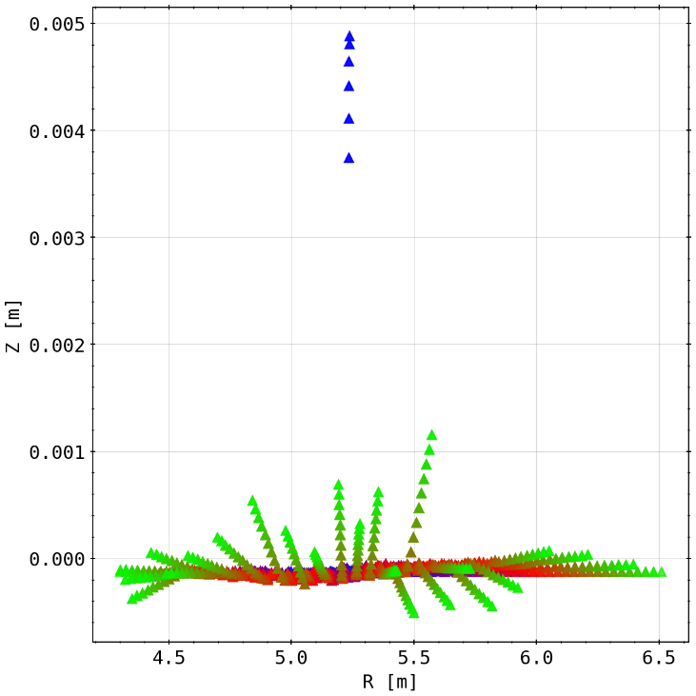
Results: Symmetry of Emissivity Matrix and Mesh
checking the symmetry (read: top-bottom congruence) of the emissivity matrix
slight deviances overall, especially some cells not touched by channels at all (equaling 100% difference here)
checking symmetry mesh matrix
blue to red to green means further outside the magnetic axis, i.e. ‘larger’ fluxsurfaces/fluxtubes
entire mesh dispositioned below (still oriented around magnetic axis)
increasing deviance with distance

Slide 5
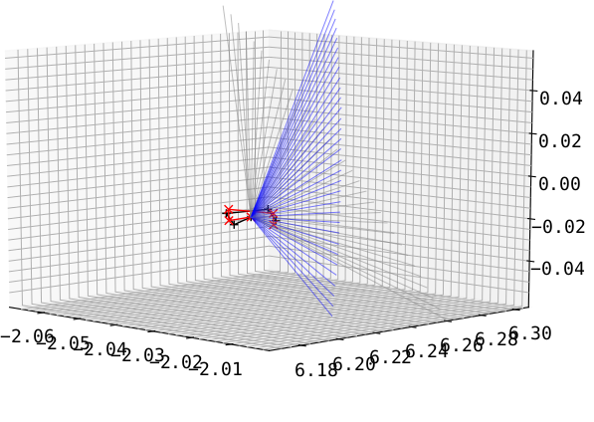
Results: Tilting the Detector Fan Up/Down
take symmetric arrays and tilt the entire fan including the aperture poloidally (grey to blue and black to red)
HBCm
(results with aperture change included)

Slide 6
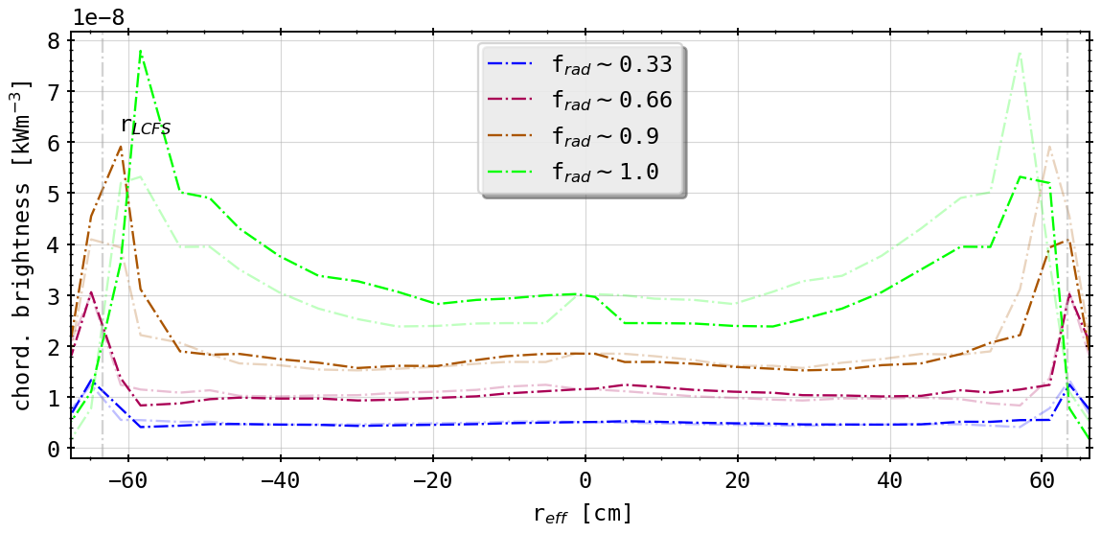
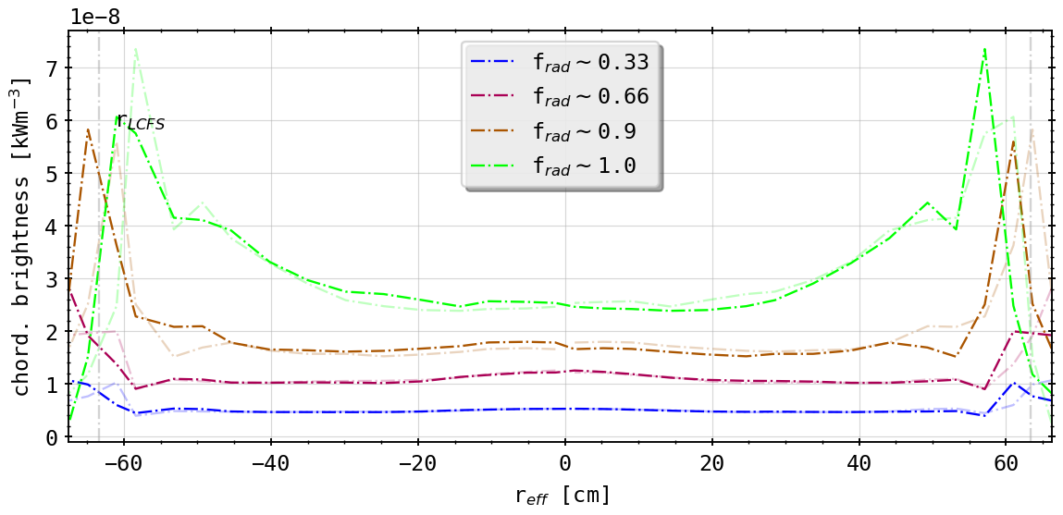
Results: Different Tilts from As-Built Geometry
(0.5° tilt (down))
(-0.5° tilt (up))
asymmetry switched around
alignment better now upside (tilt down!)
likewise radial movement as before!

Slide 7
First Summary
geometry sensitivity study yields great insight on how the camera setup and errors effect forward calculations
conclusions however indefinite of what is exactly responsible for asymmetry
Camera geometry adequate to resolve radial shifts in 2D from STRAHL?
need 2D tomography of radiation distribution
benchmark Minimum Fischer Reqularization method for 2D inversion with variety of phantom radiation profiles with various distinct or mixed characteristics

Slide 8
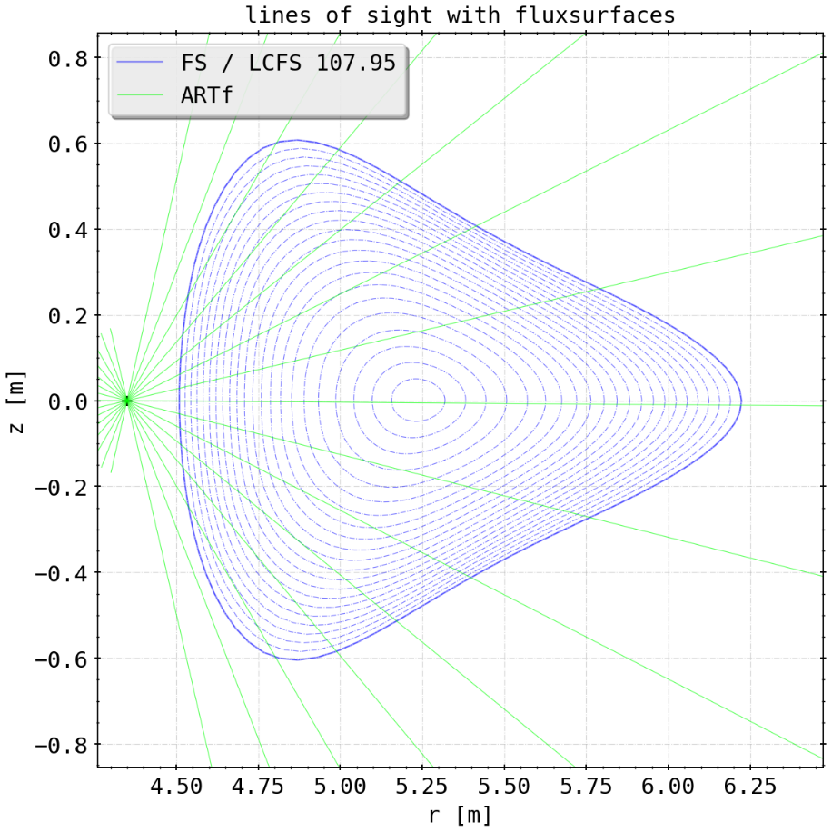
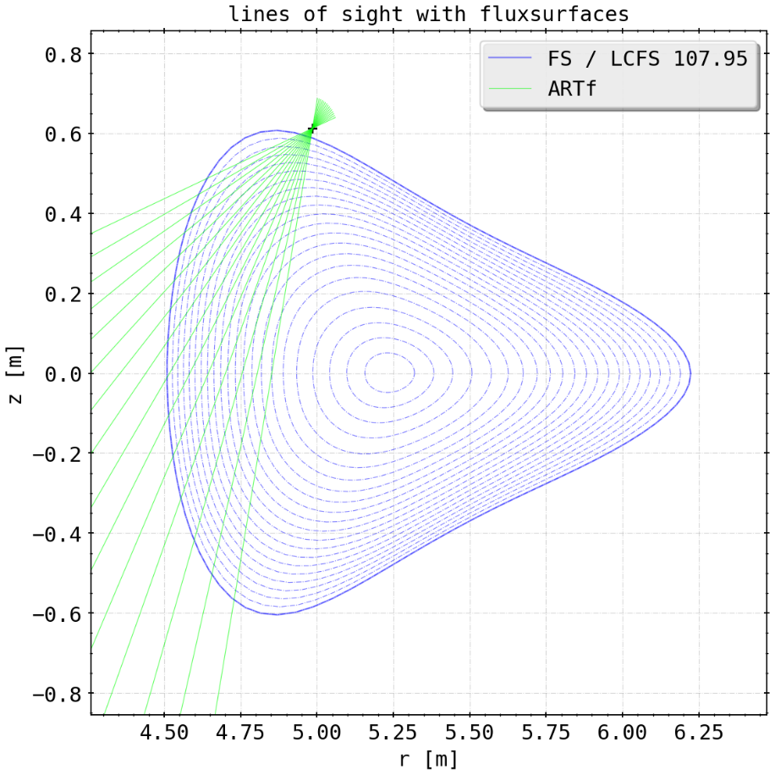
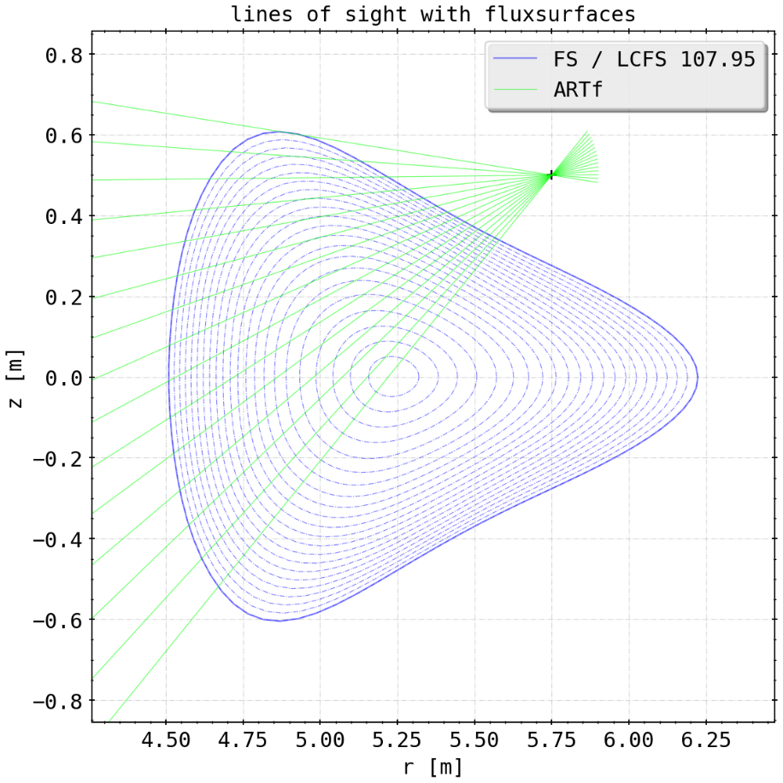
New Cameras
ARTm (3)
ARTv (1)
ARTh (2)

Slide 9
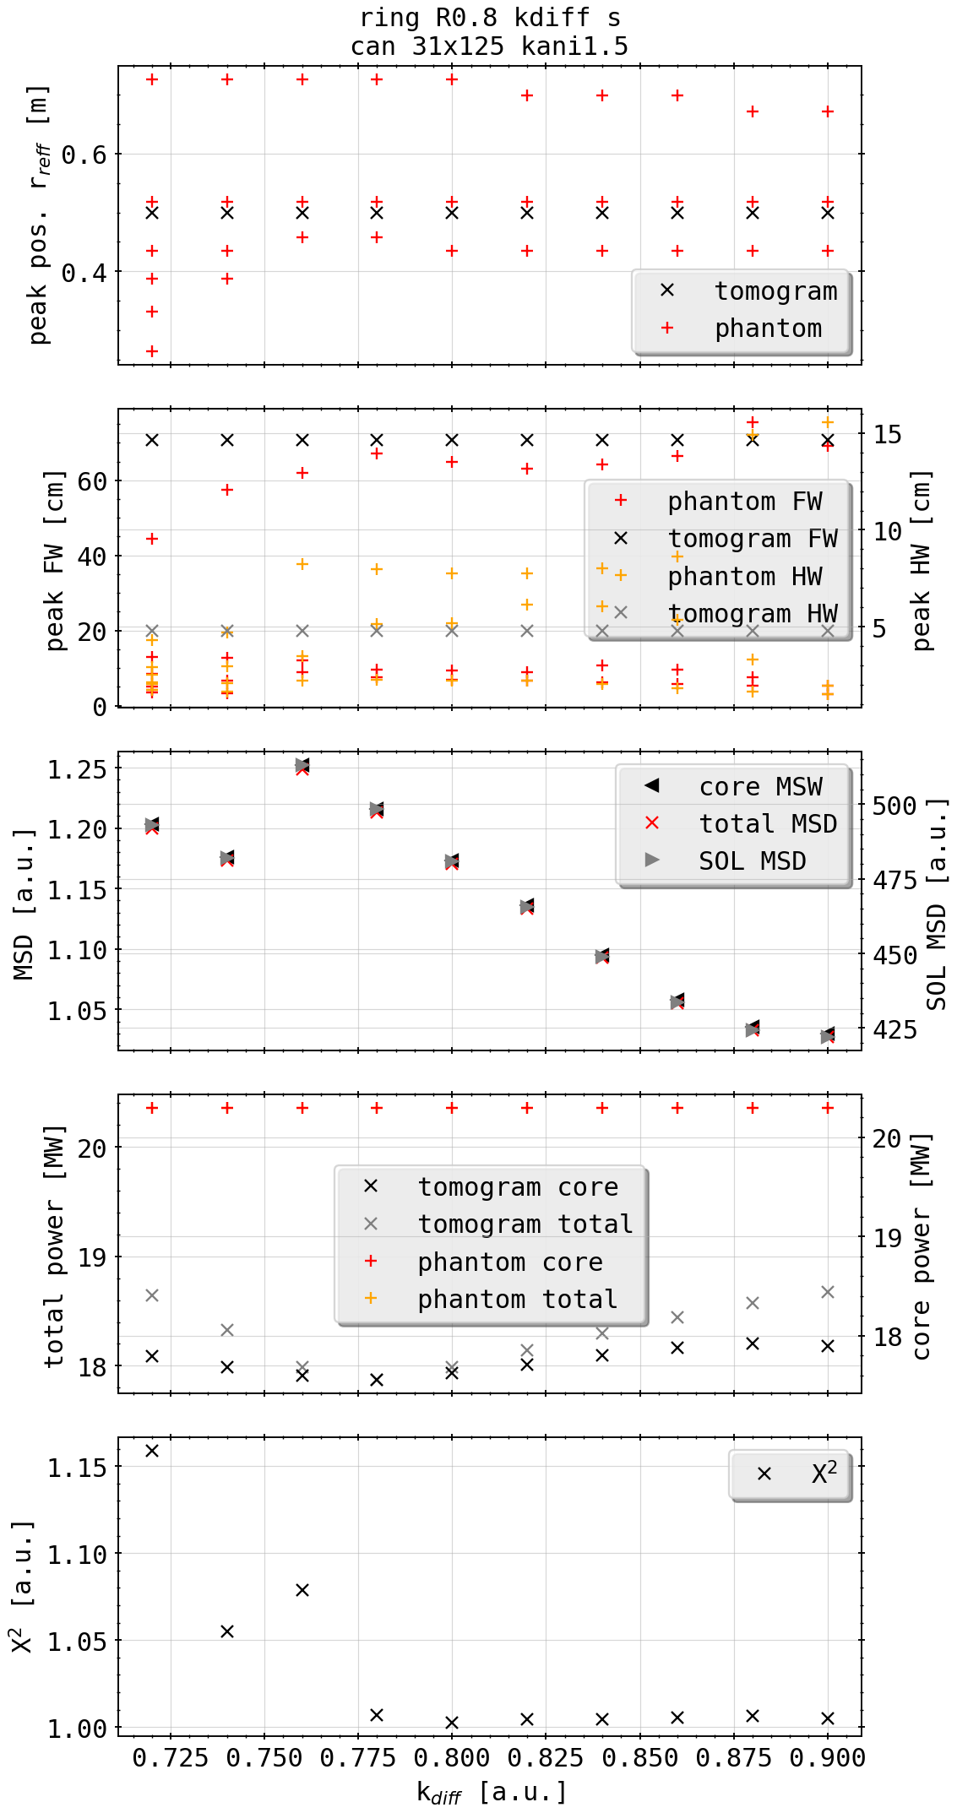
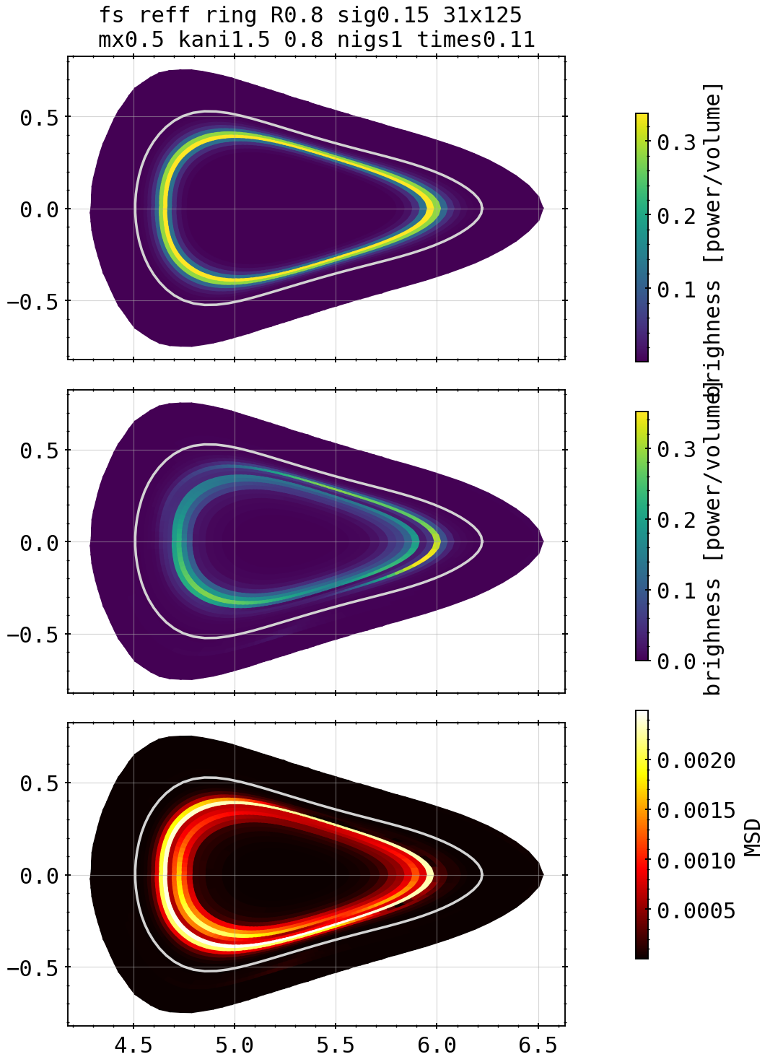
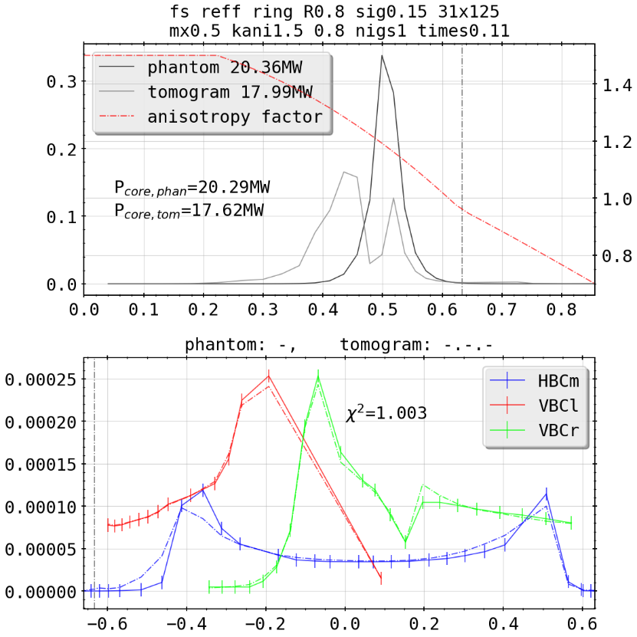
Phatom Tests: Ring @0.8
example
kdiff scan

Slide 10
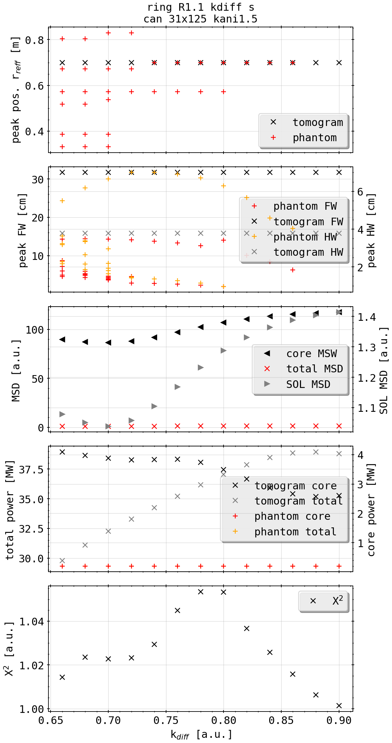
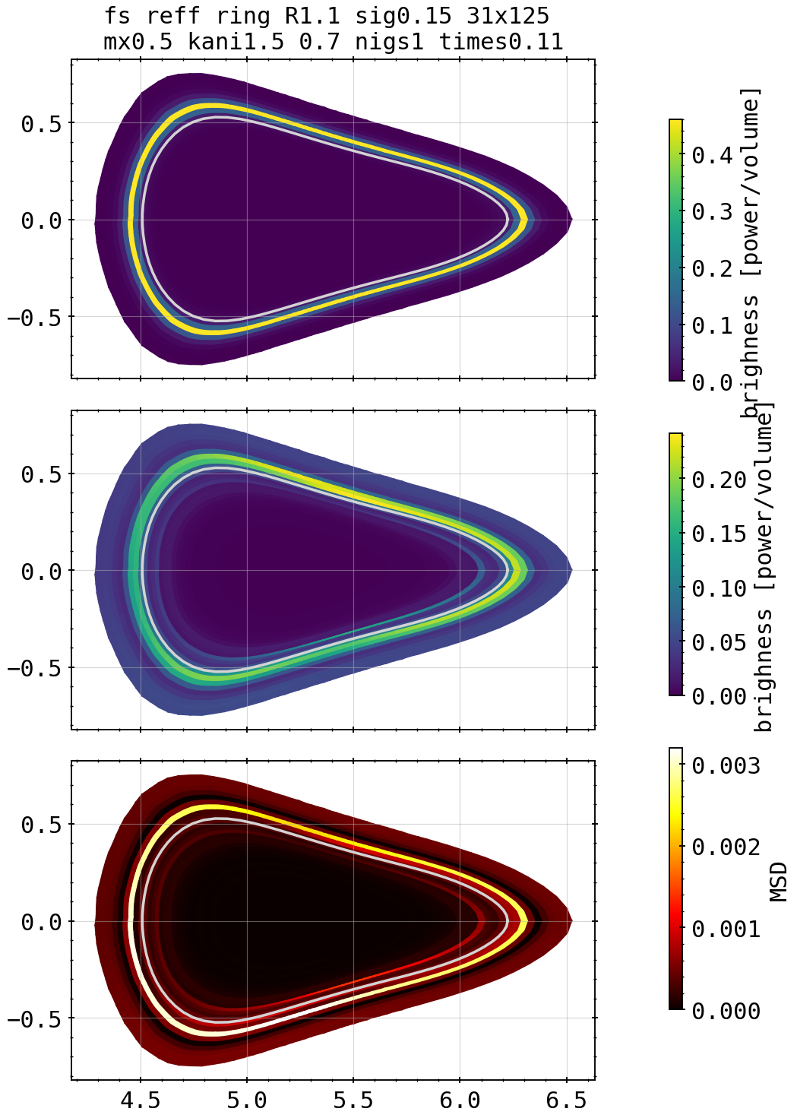
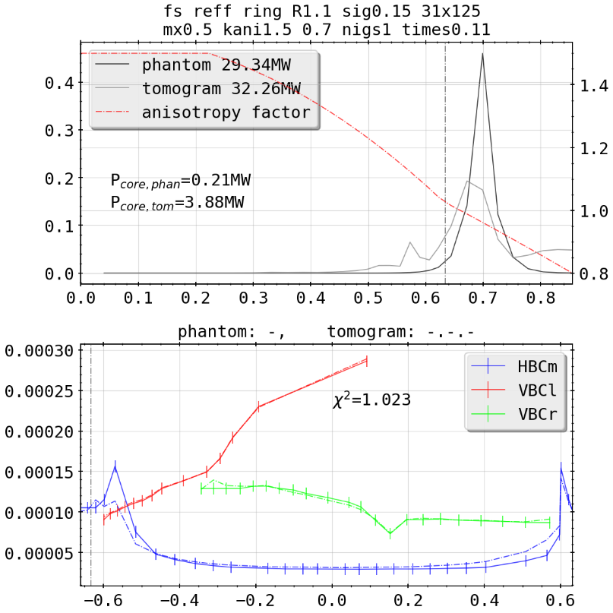
Phatom Tests: Ring @1.1
example
kdiff scan

Slide 11
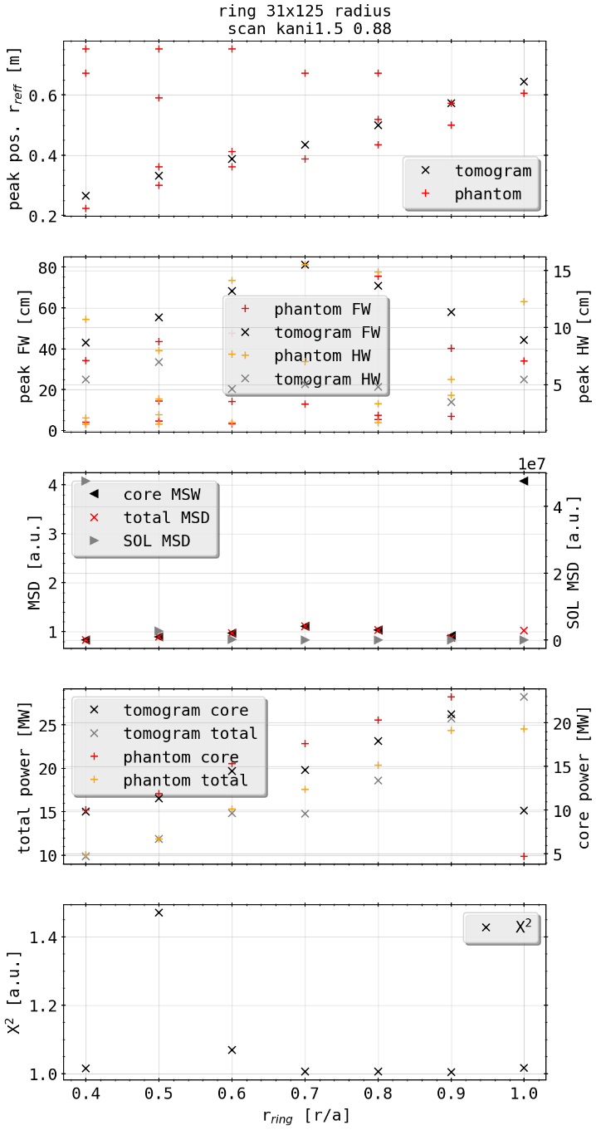
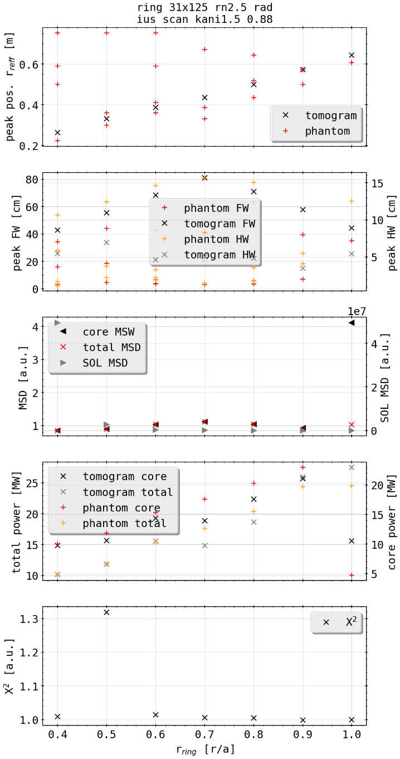
Phatom Tests: Ring @0.8 w (w/o) Random Noise
kdiff scan; w/o nosie
kdiff scan; with nosie

Slide 12
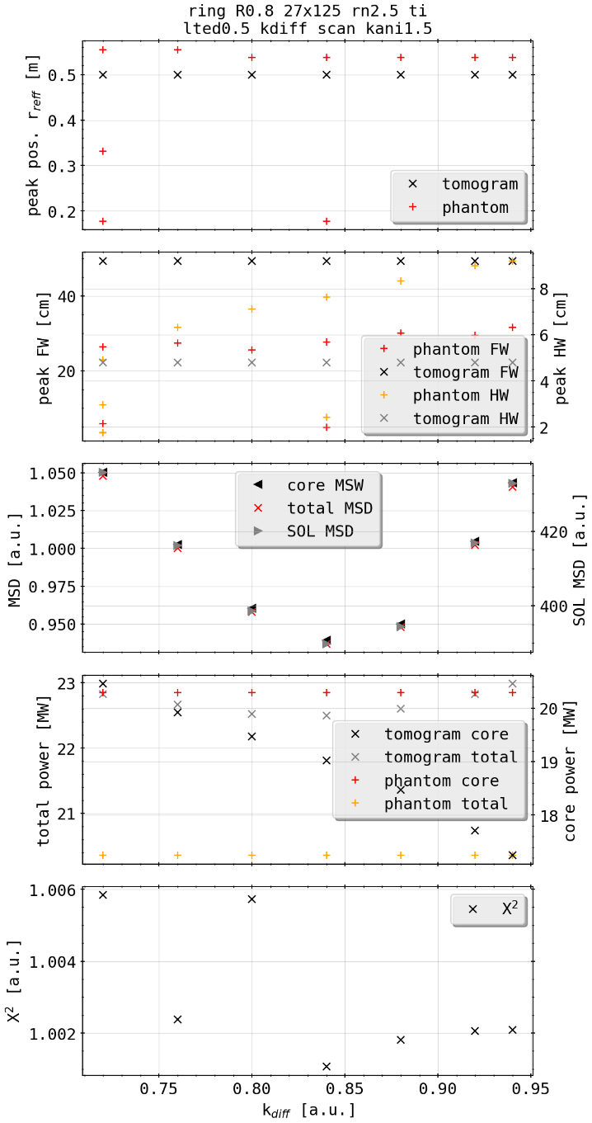
Phatom Tests: Ring @0.8 with Tilted Camera Setup
kdiff scan; with 2.5% noise
0.5° anit-clockwise tilt
kdiff scan; w/o nosie

Slide 13
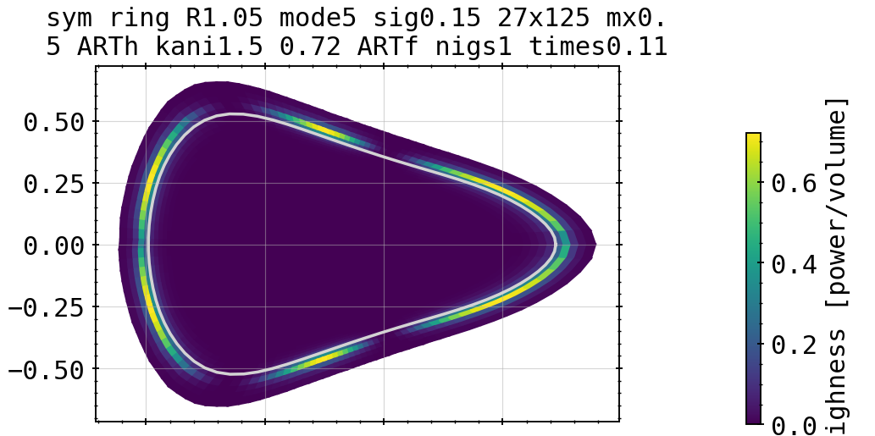
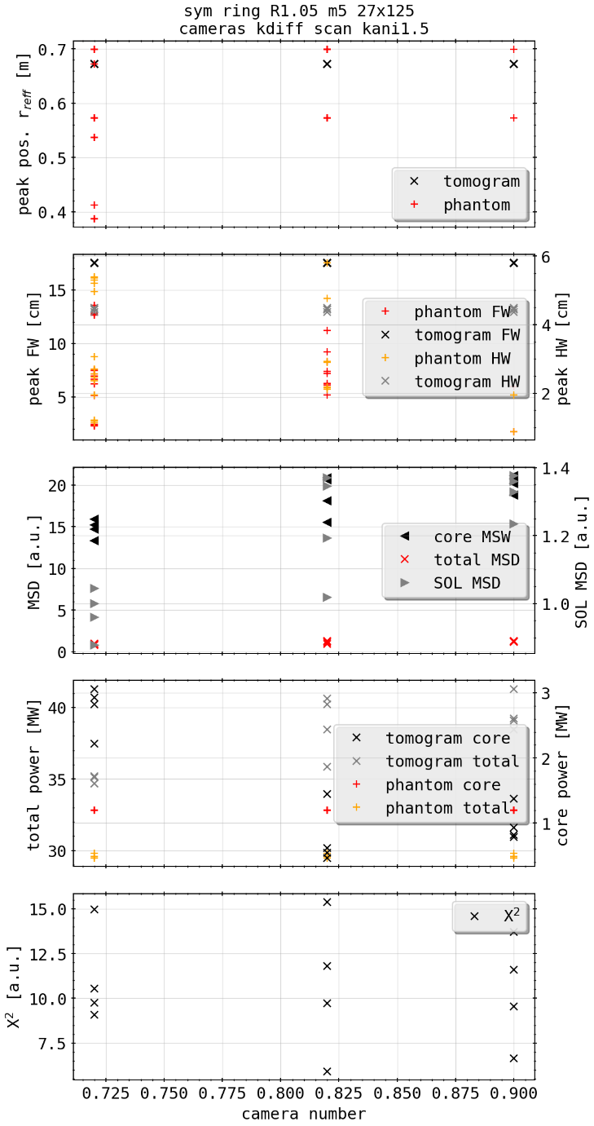
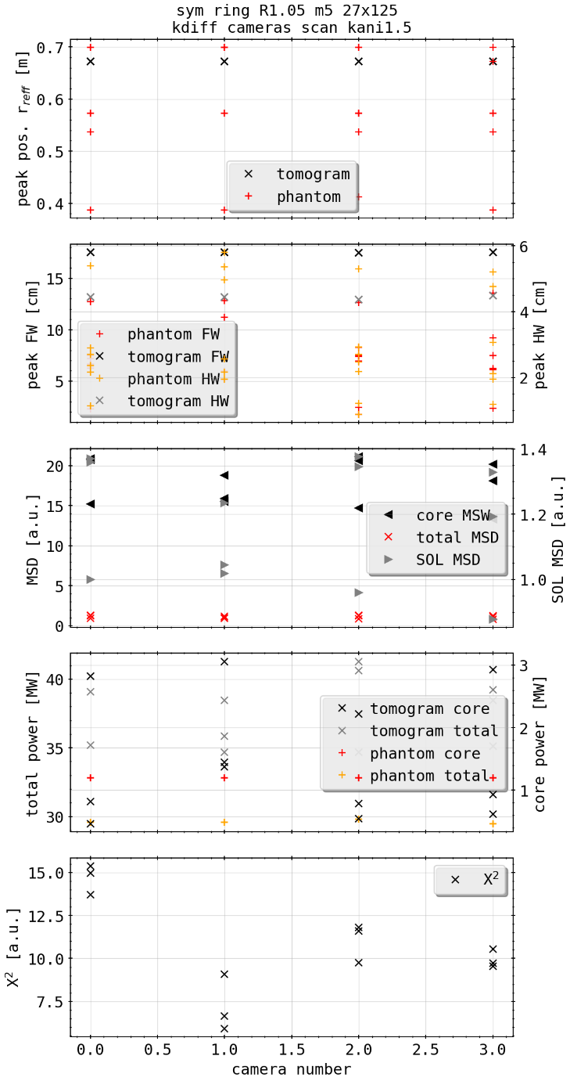
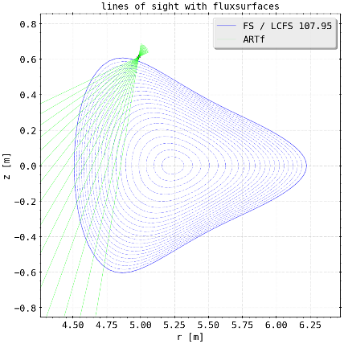
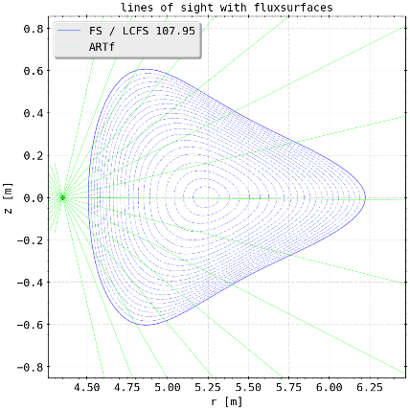
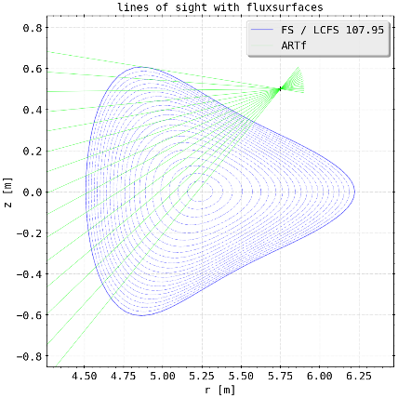
Phatom Tests: Ring @0.8 with Tilted Camera Setup
ARTm (3)
1
2
2

Slide 14
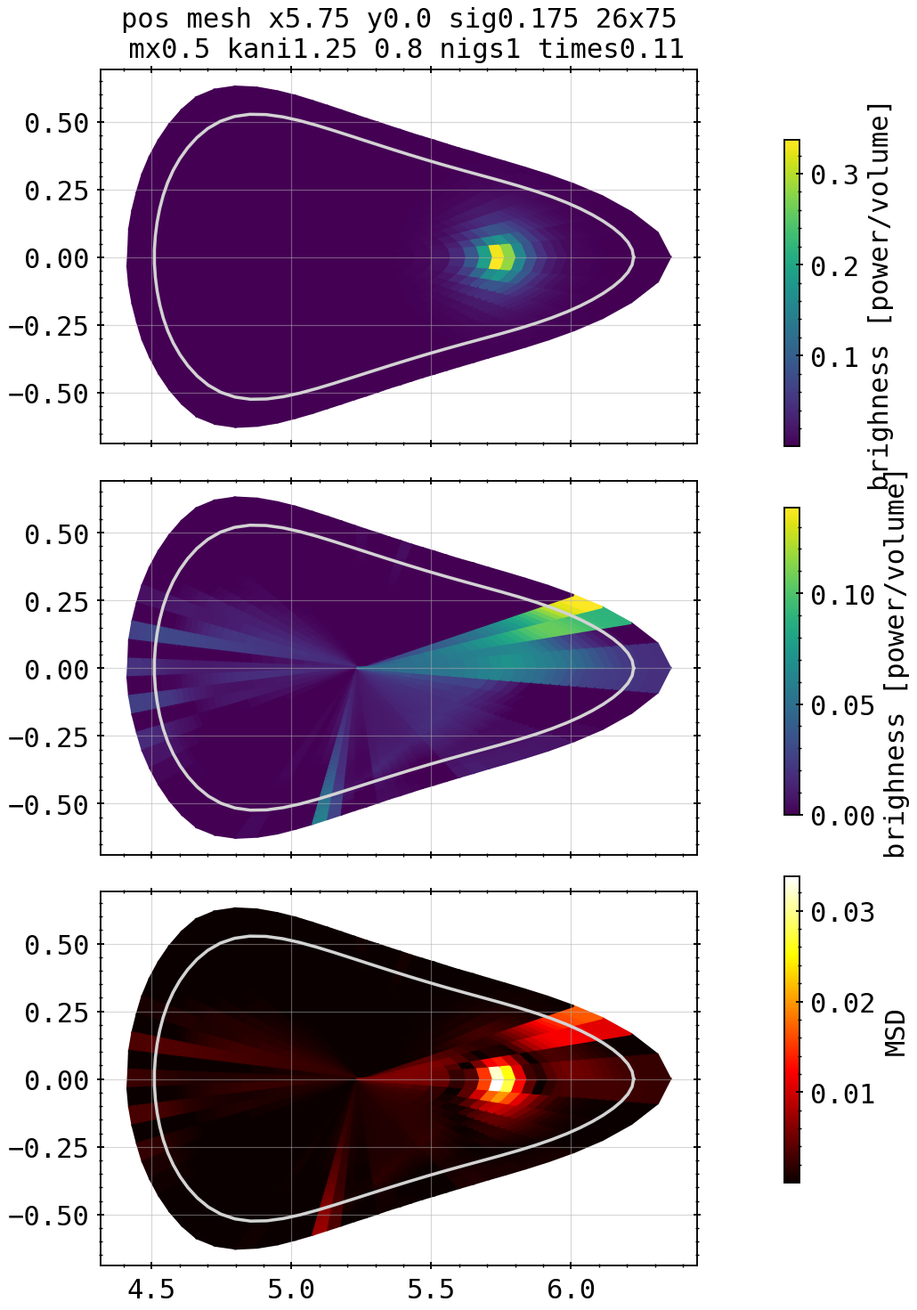
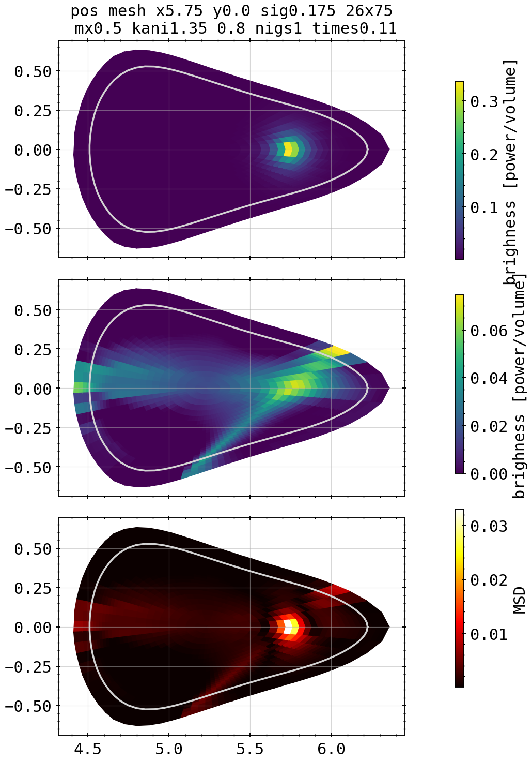
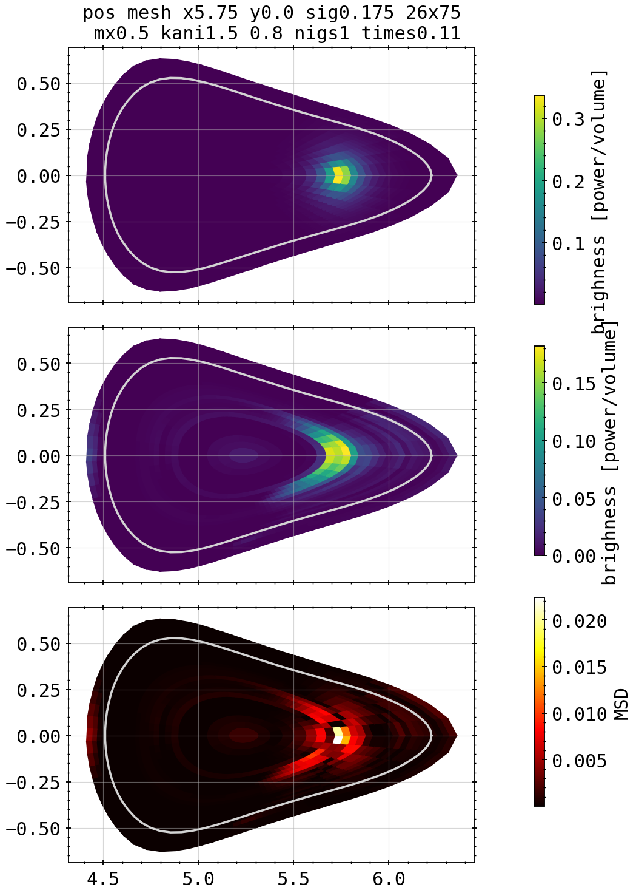
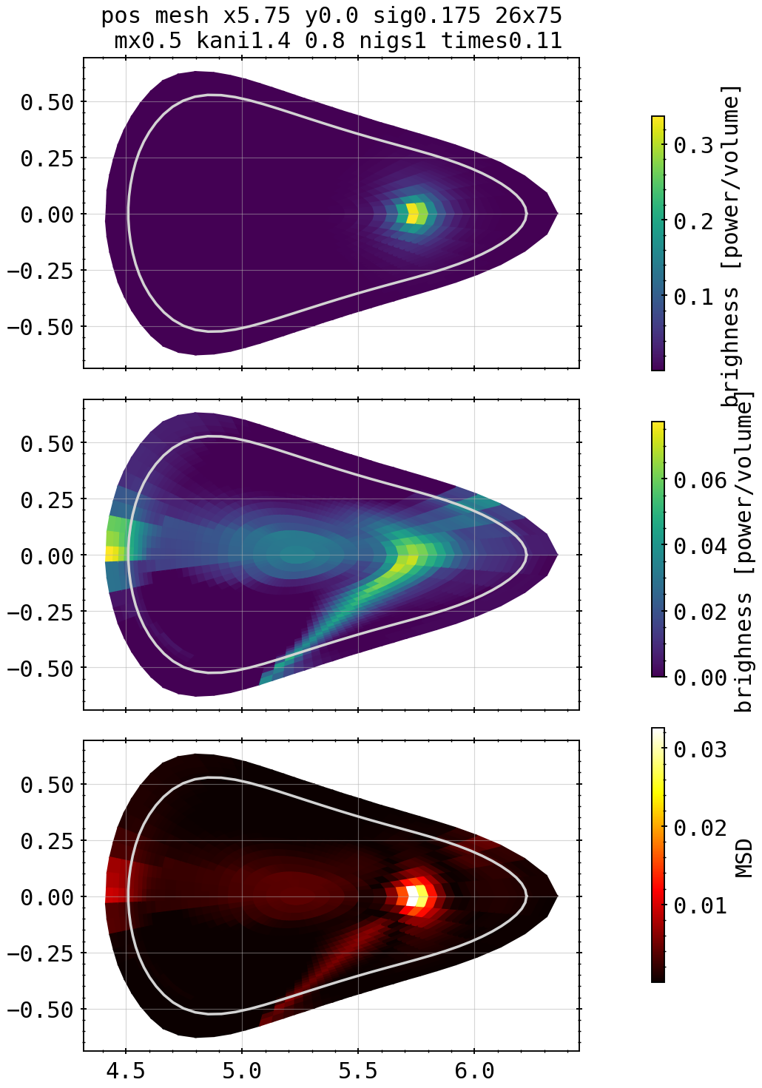
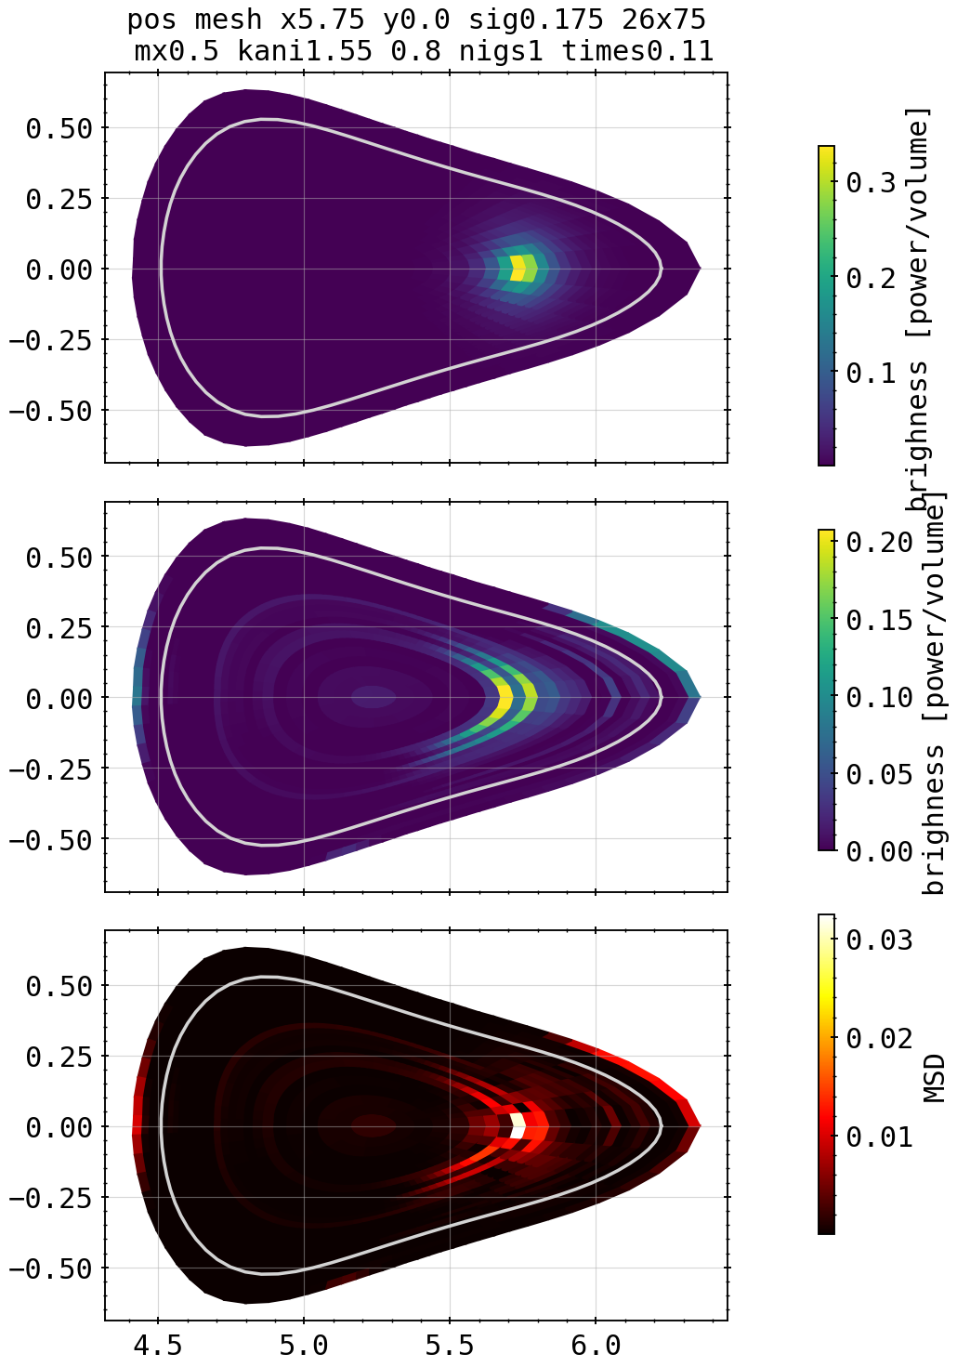
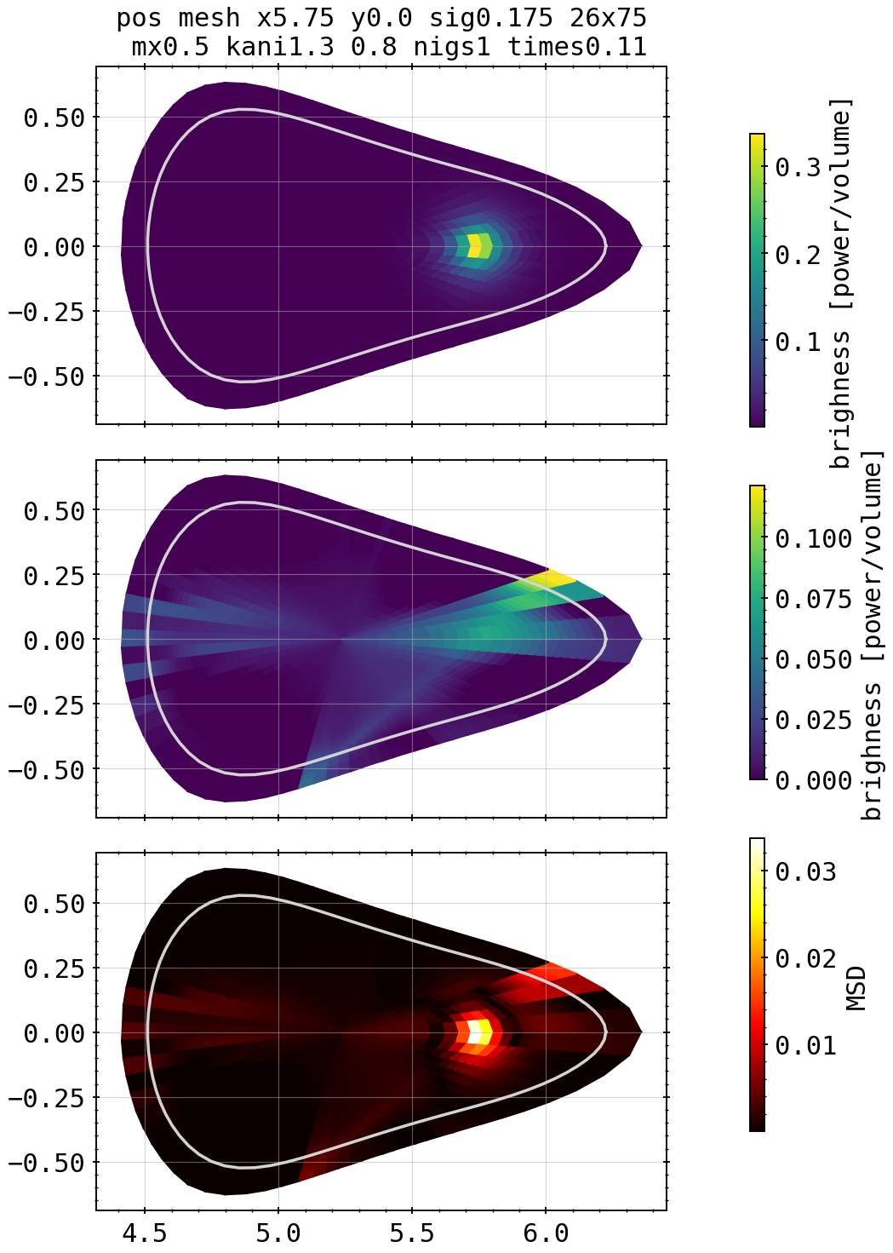
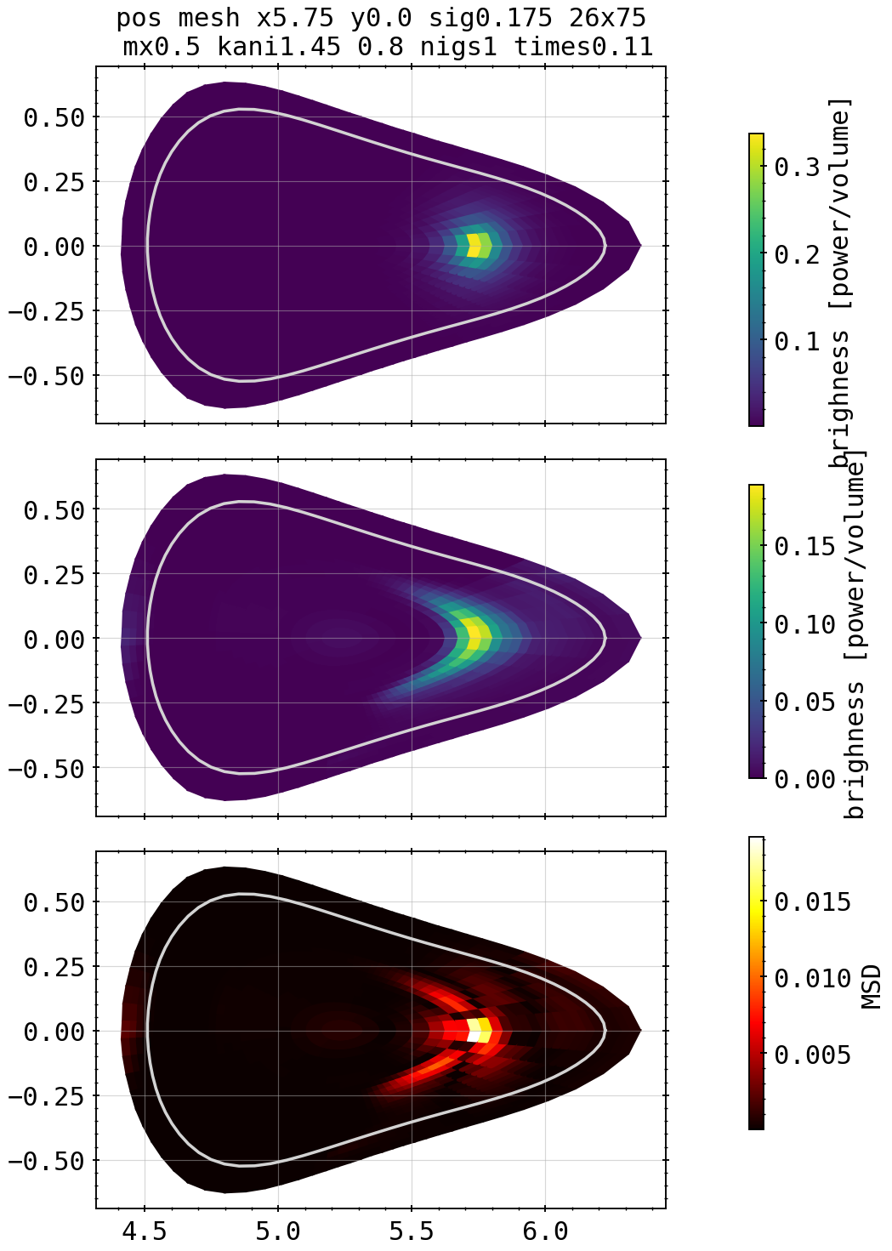
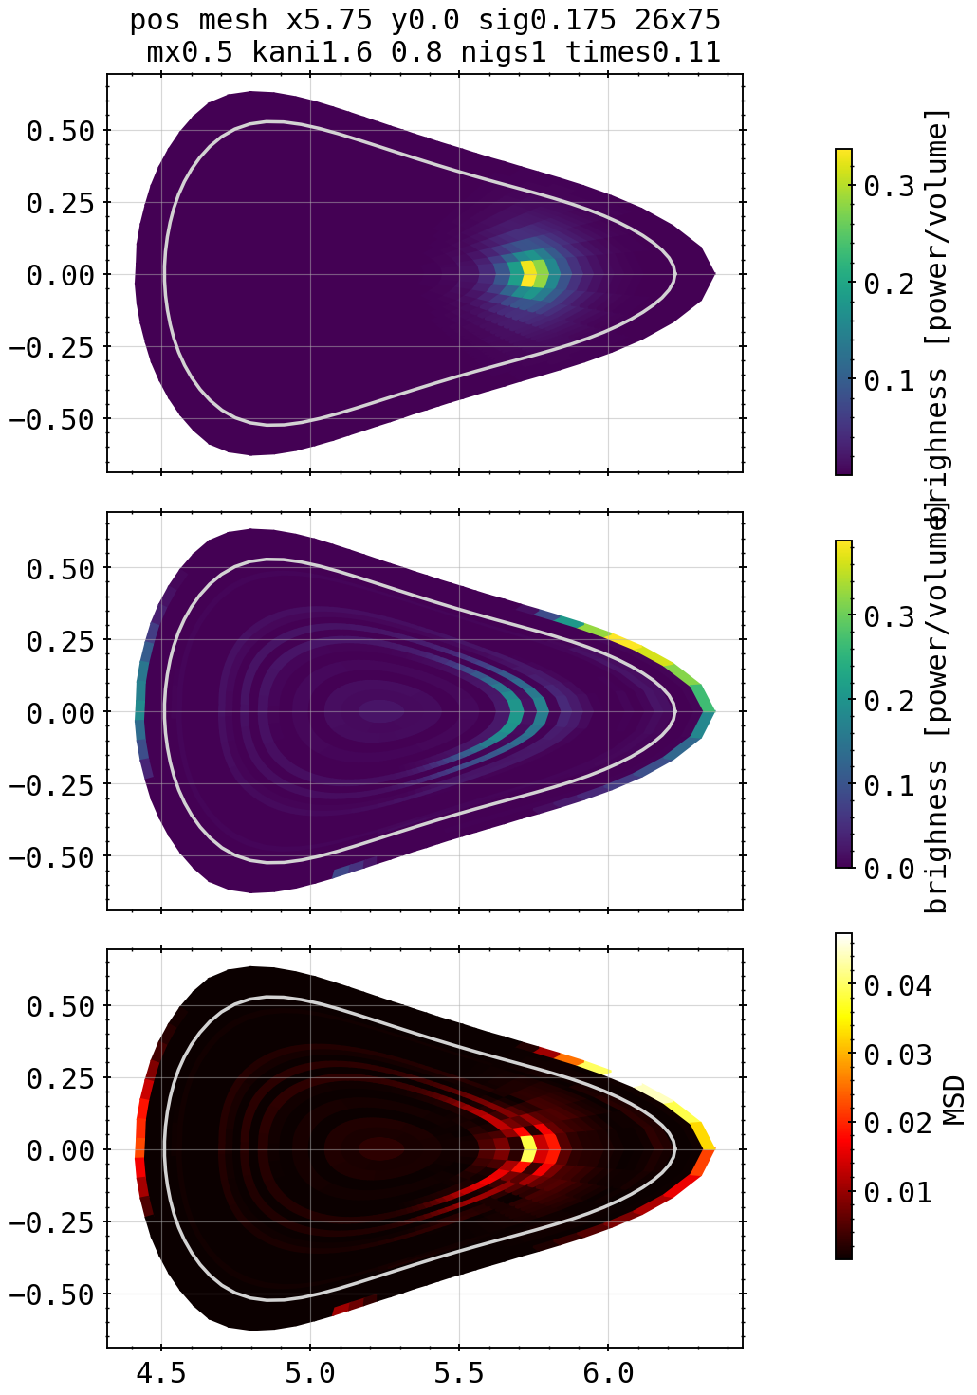
Phantoms: Asymmetric Spot Core Scan
1.35
1.5
X²=8.83
X²=1.43
Kcore=1.25, kdiff=0.8
1.4
1.55
X²=13.6
X²=12.27
X²=2.0
1.3
1.45
1.6
X²=8.0
X²=1.094
X²=6.98

Slide 15
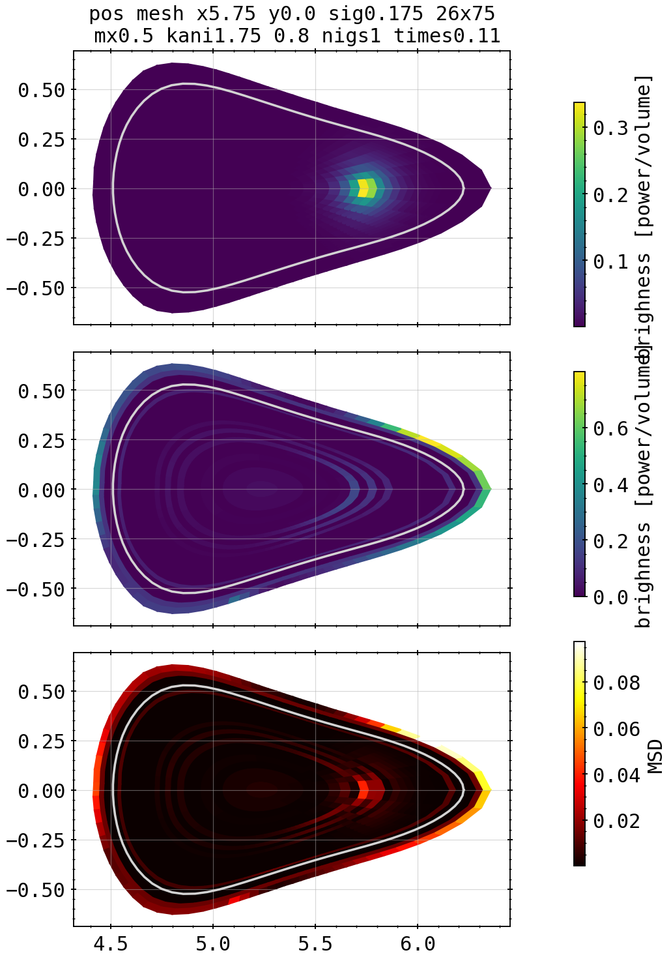
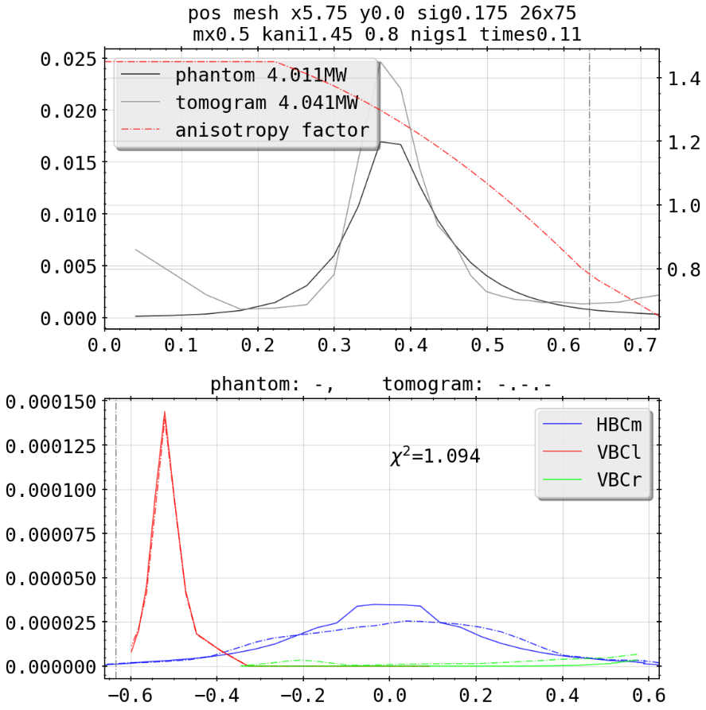
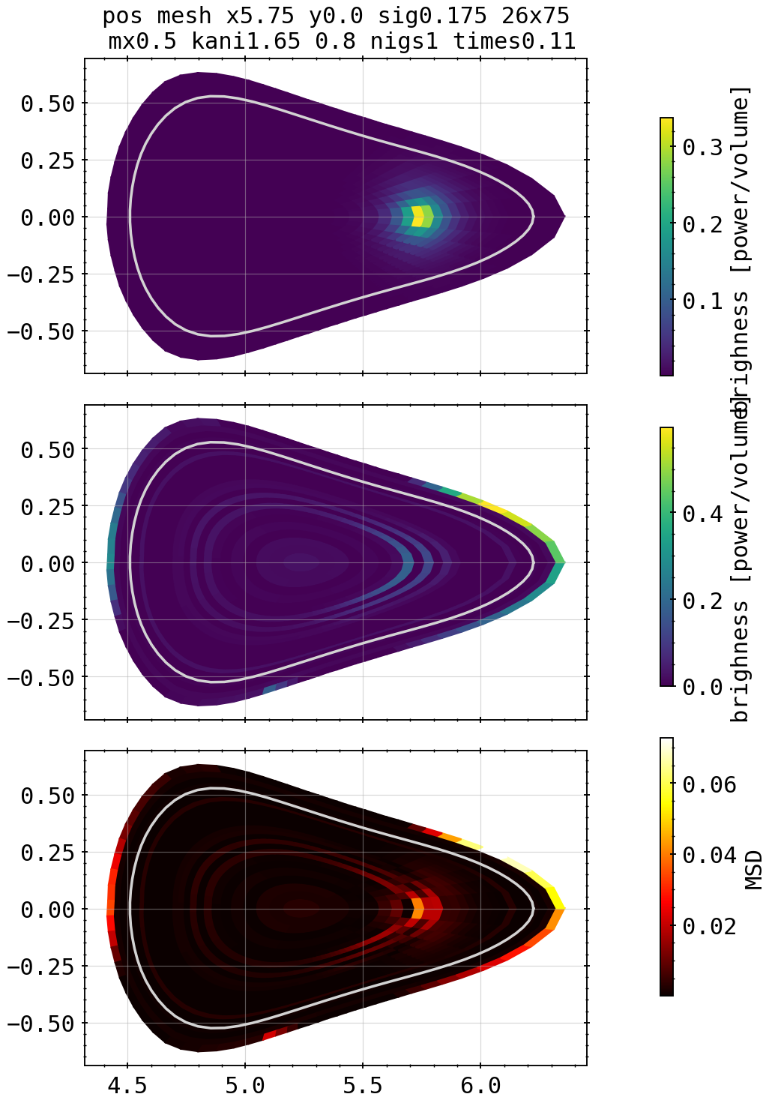
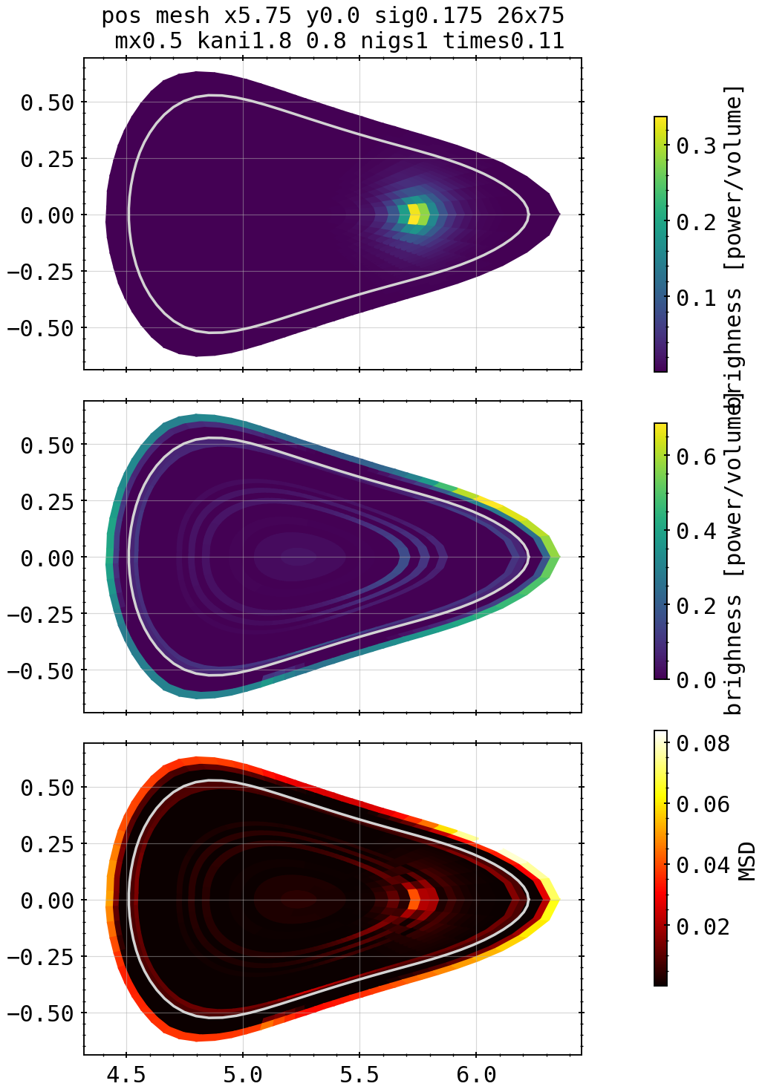

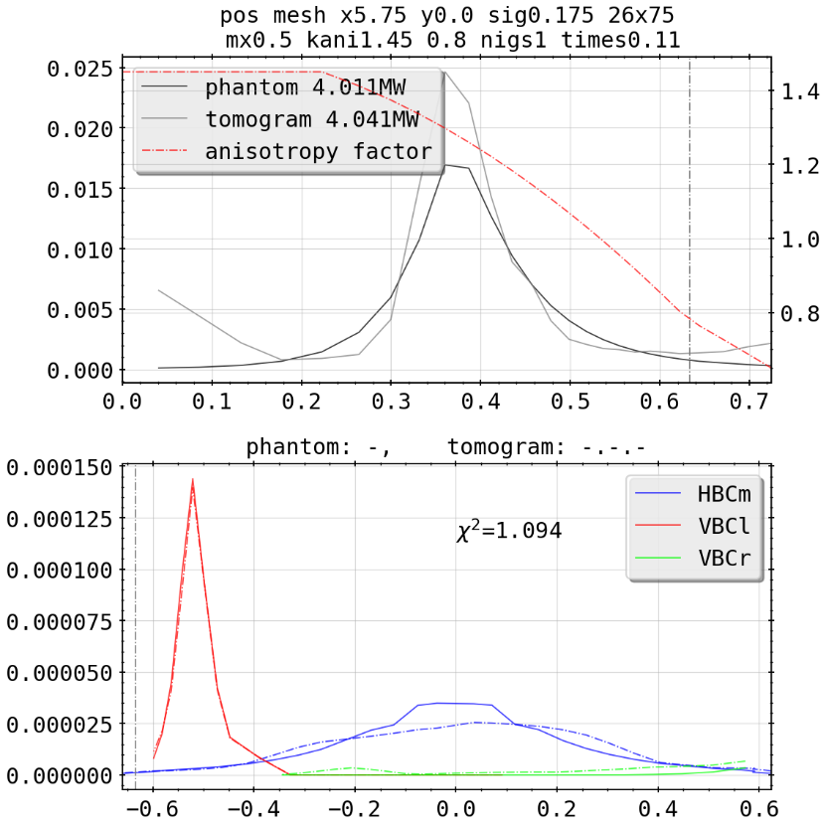

Phantoms: Asymmetric Spot Core Scan
1.75
X²=180.9
1.65
1.8
X²=28.75
X²=317.9
1.7
X²=82.28

Slide 16
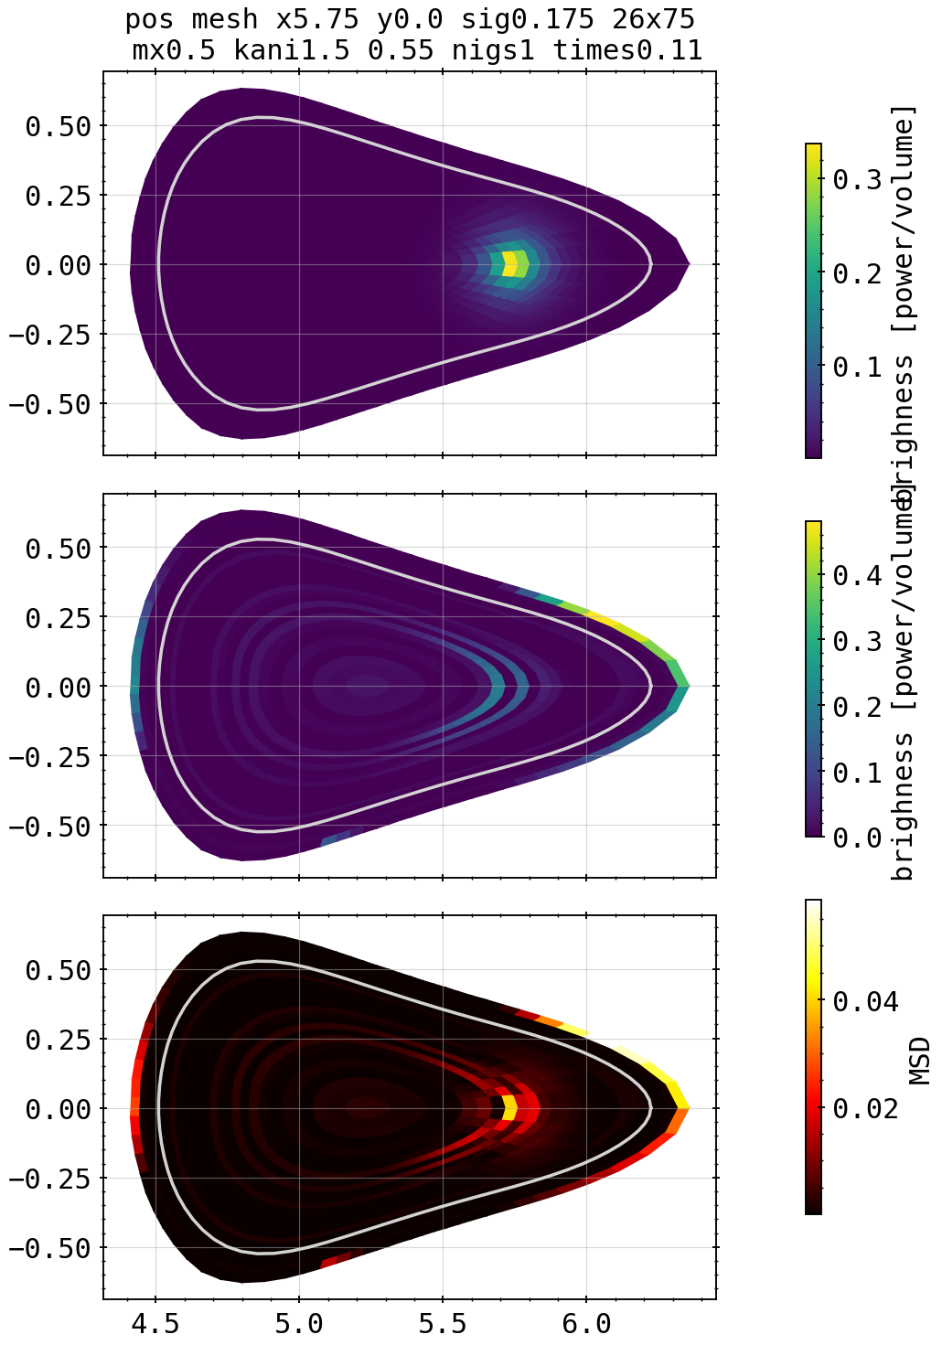
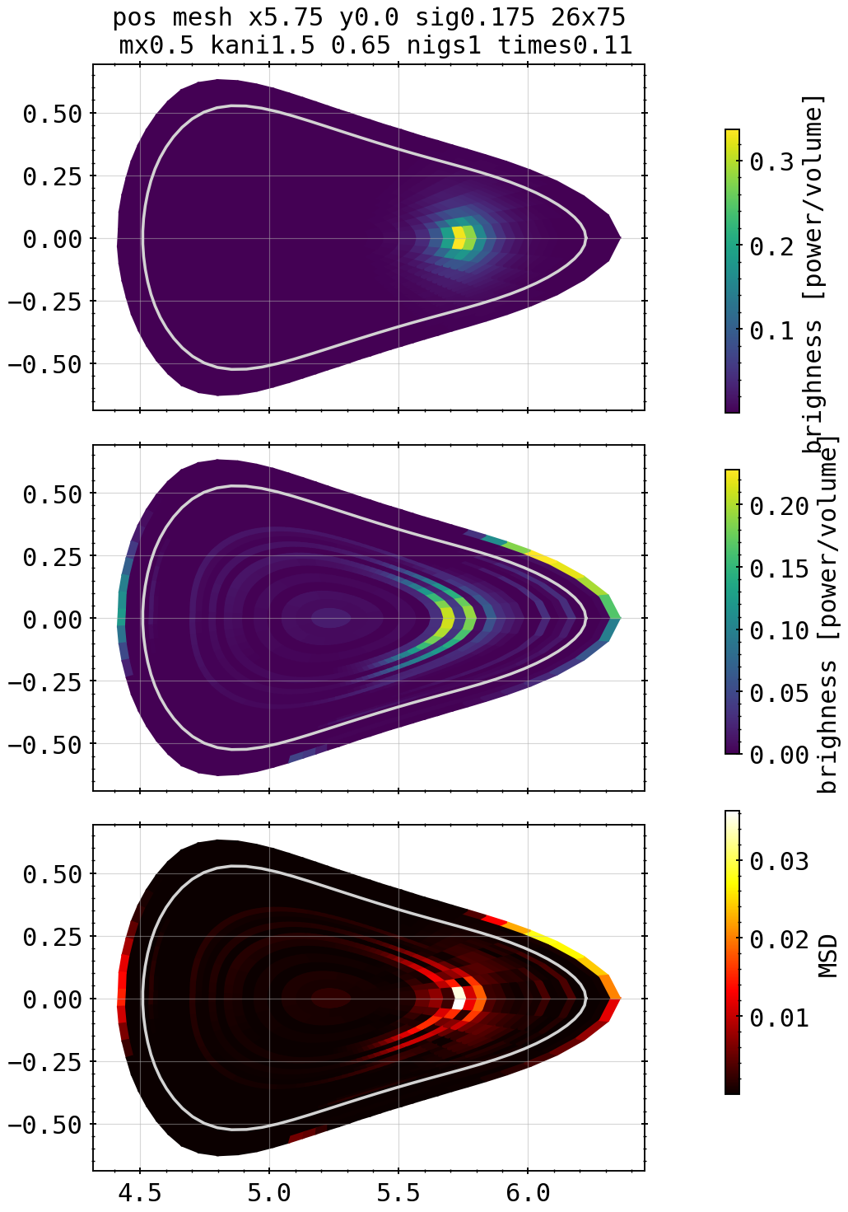



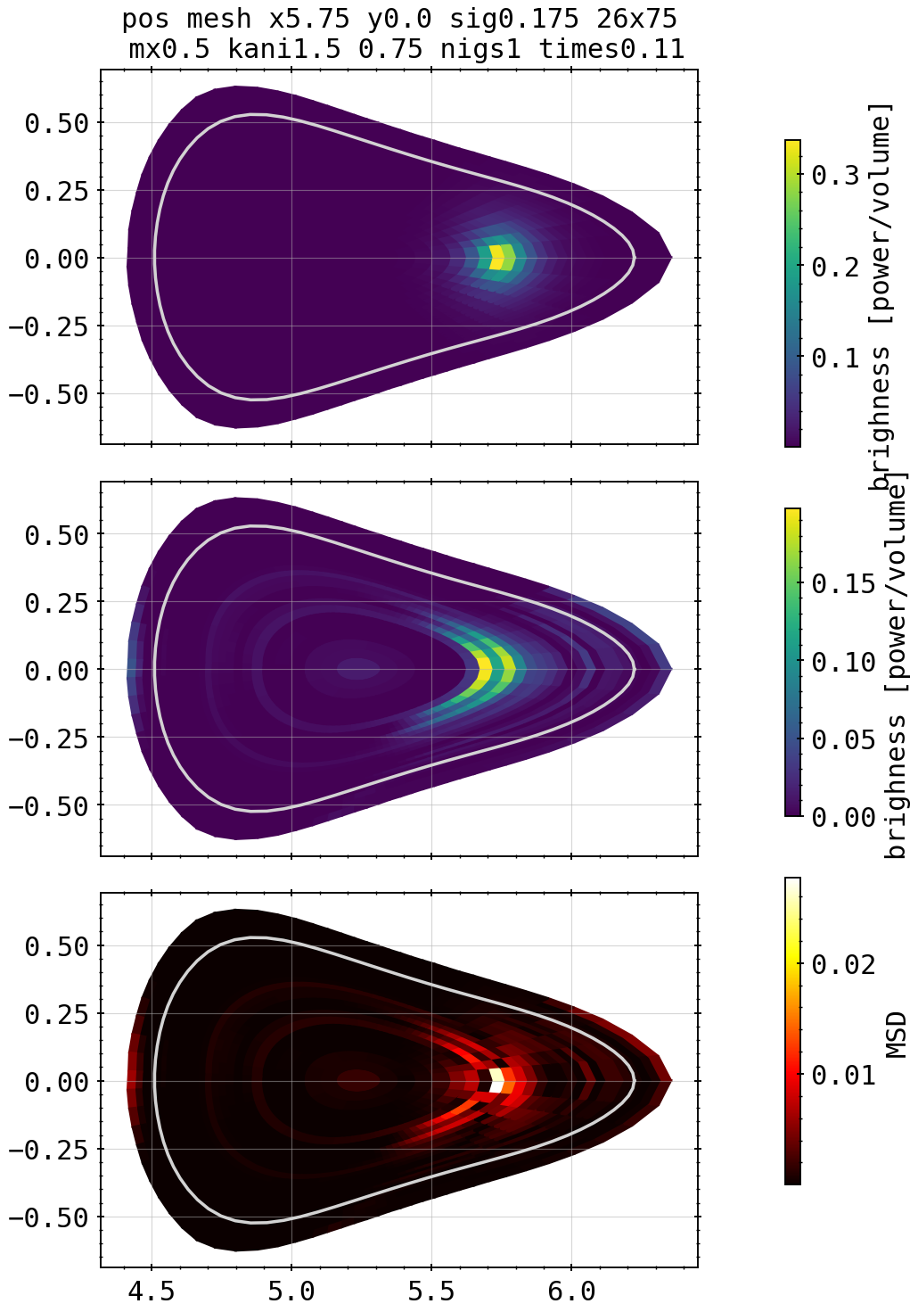
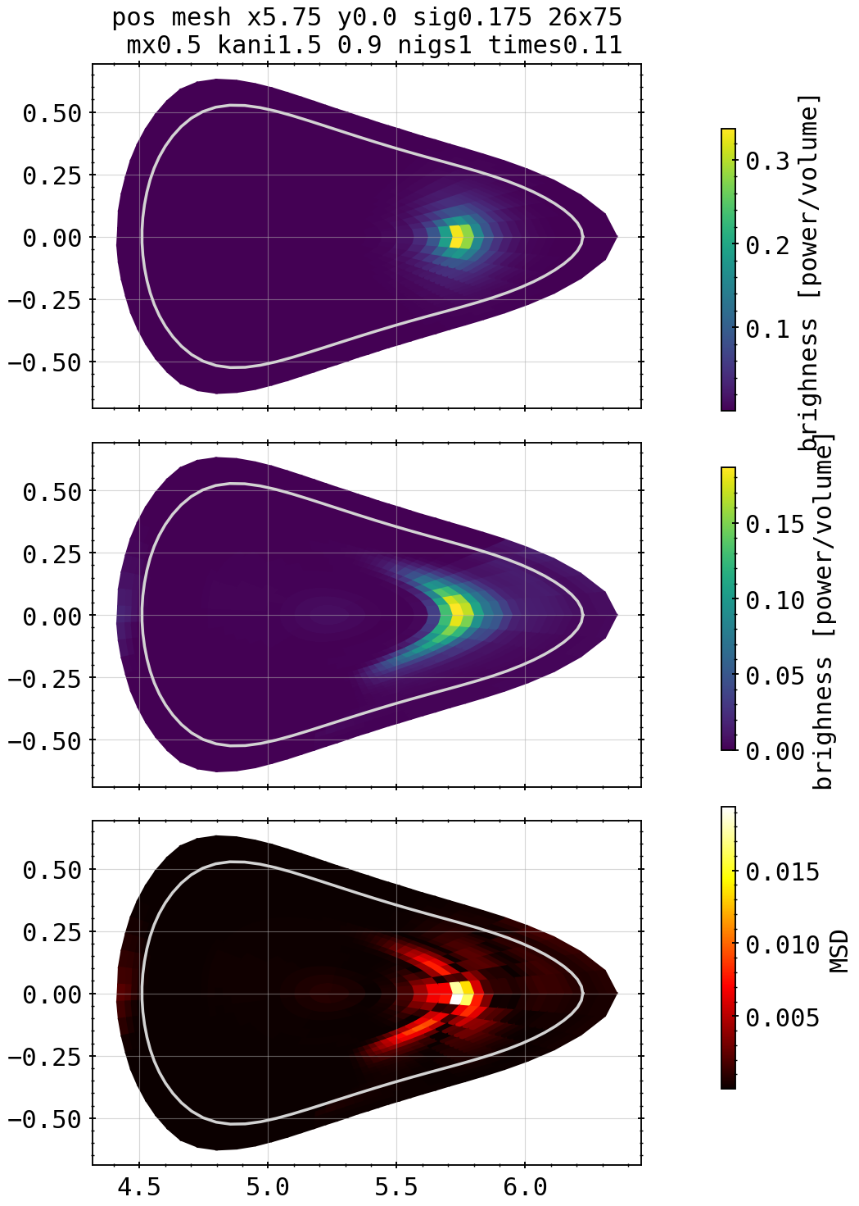
Phantoms: Asymmetric Spot Edge Scan
0.65
0.8
X²=3.01
X²=1.43
Kcore=1.5, kdiff=0.55
0.7
0.85
X²=11.63
X²=1.99
X²=1.27
0.6
0.75
0.9
X²=6.58
X²=1.69
X²=1.09

Slide 17




Phantoms: Asymmetric Spot Core Scan
1.05
X²=10.07
0.95
X²=1.04
1.0
X²=11.7

Slide 18
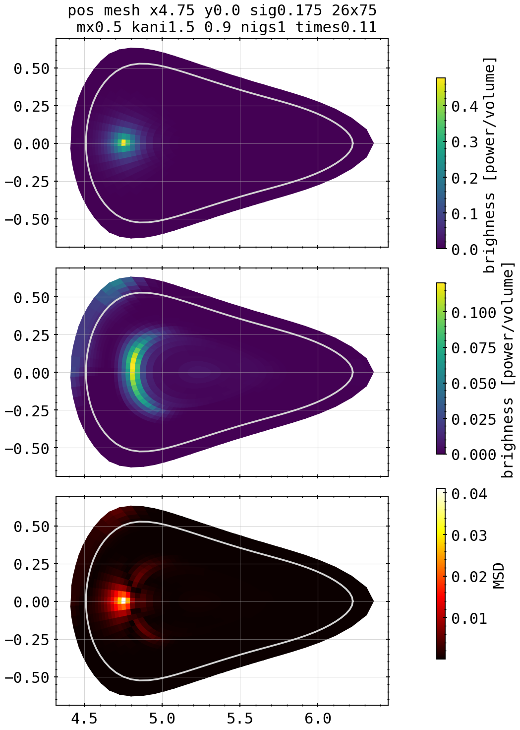
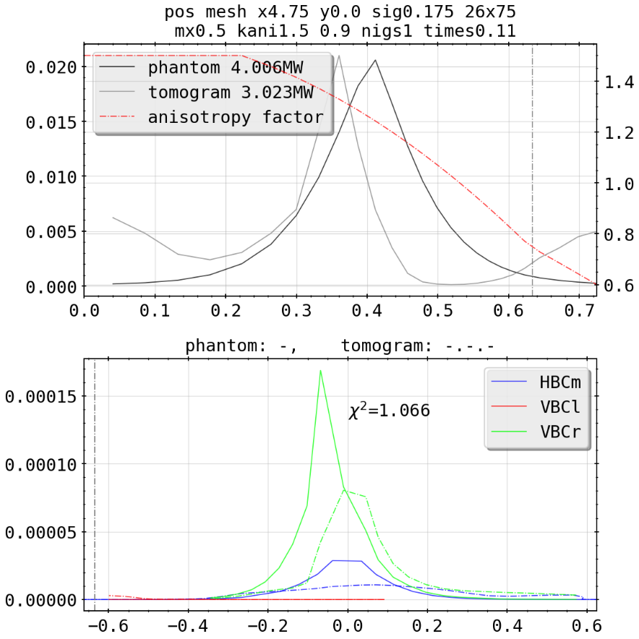
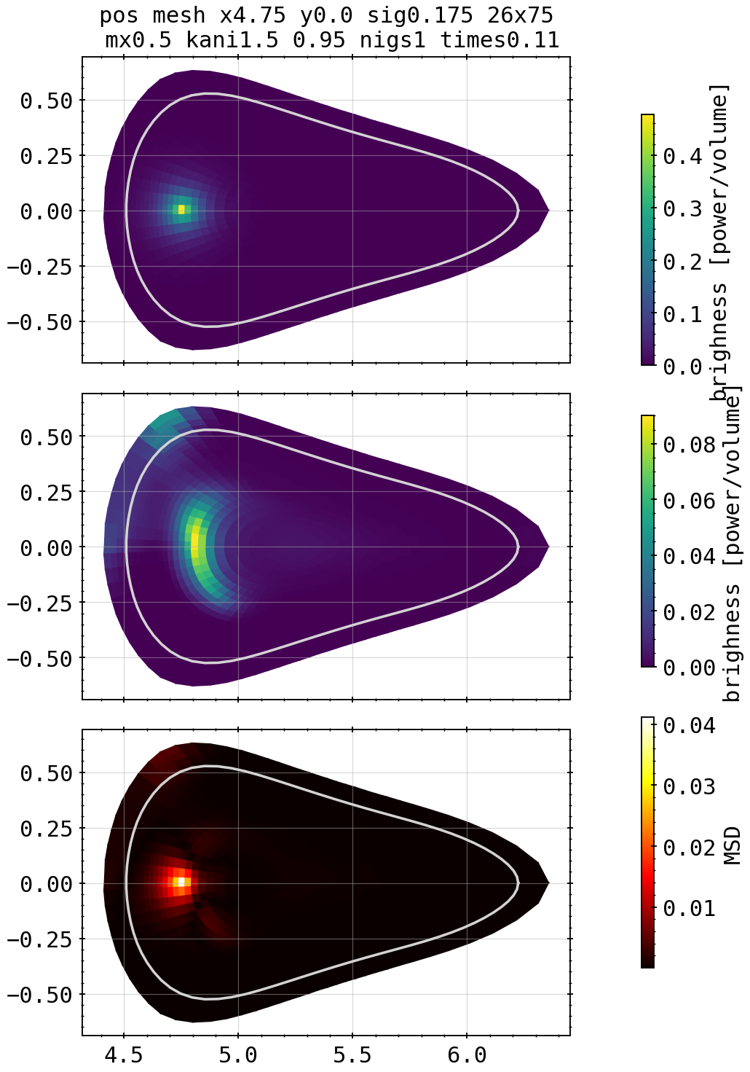
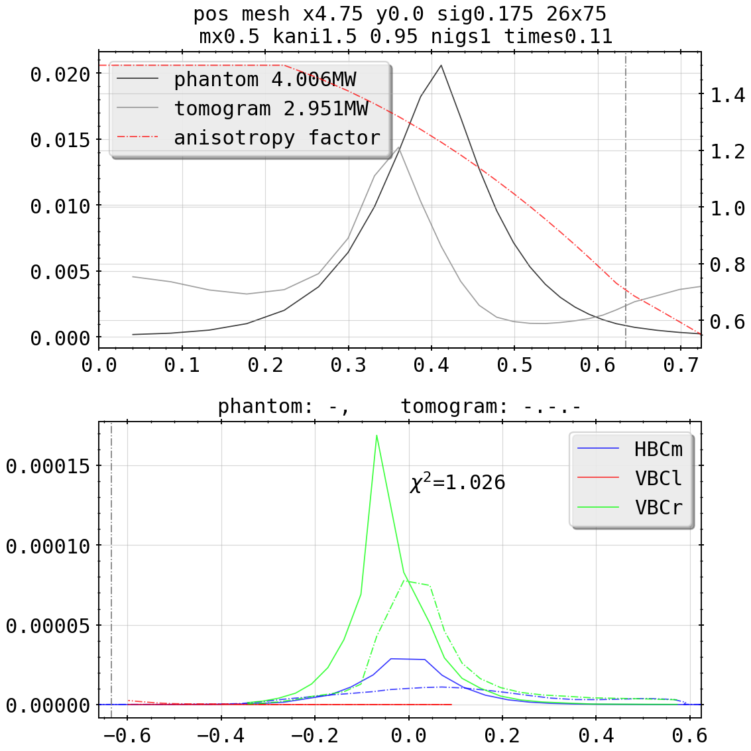
Phantoms: Asymmetric Spot (Flipped) Edge Scan
0.95
X²=1.03
Kcore=1.5, kdiff=0.9
X²=1.07

Slide 19
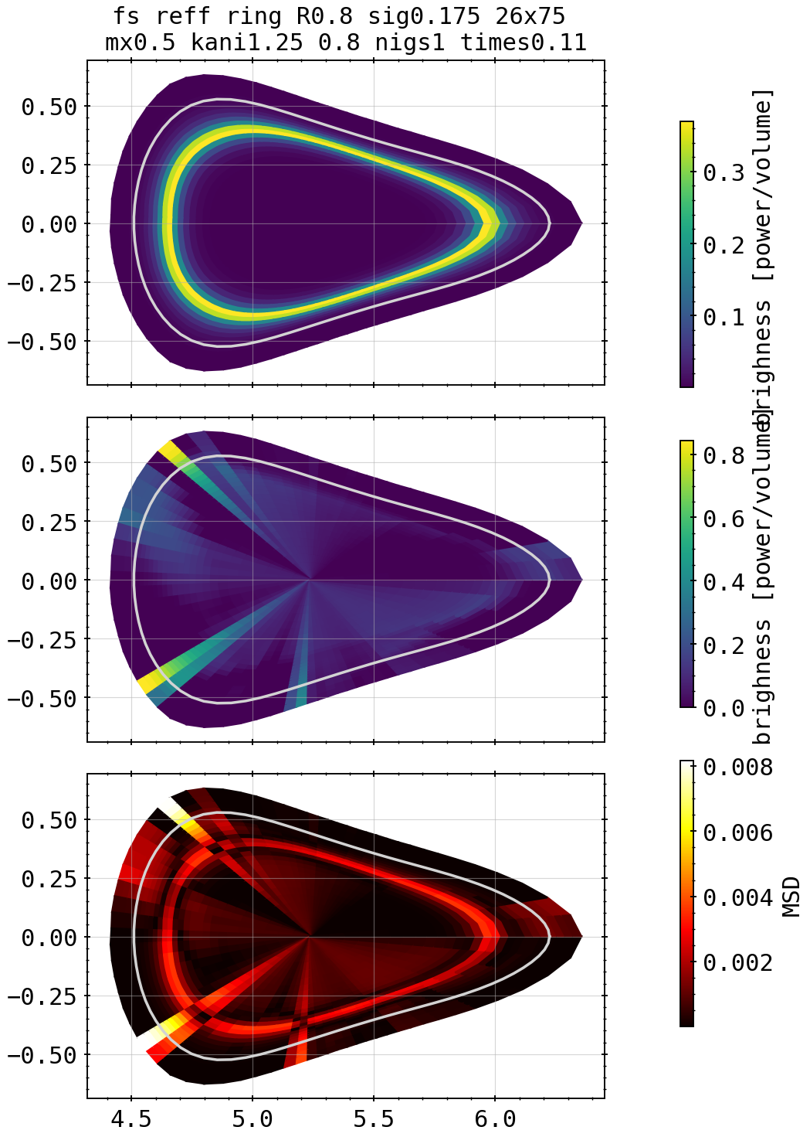
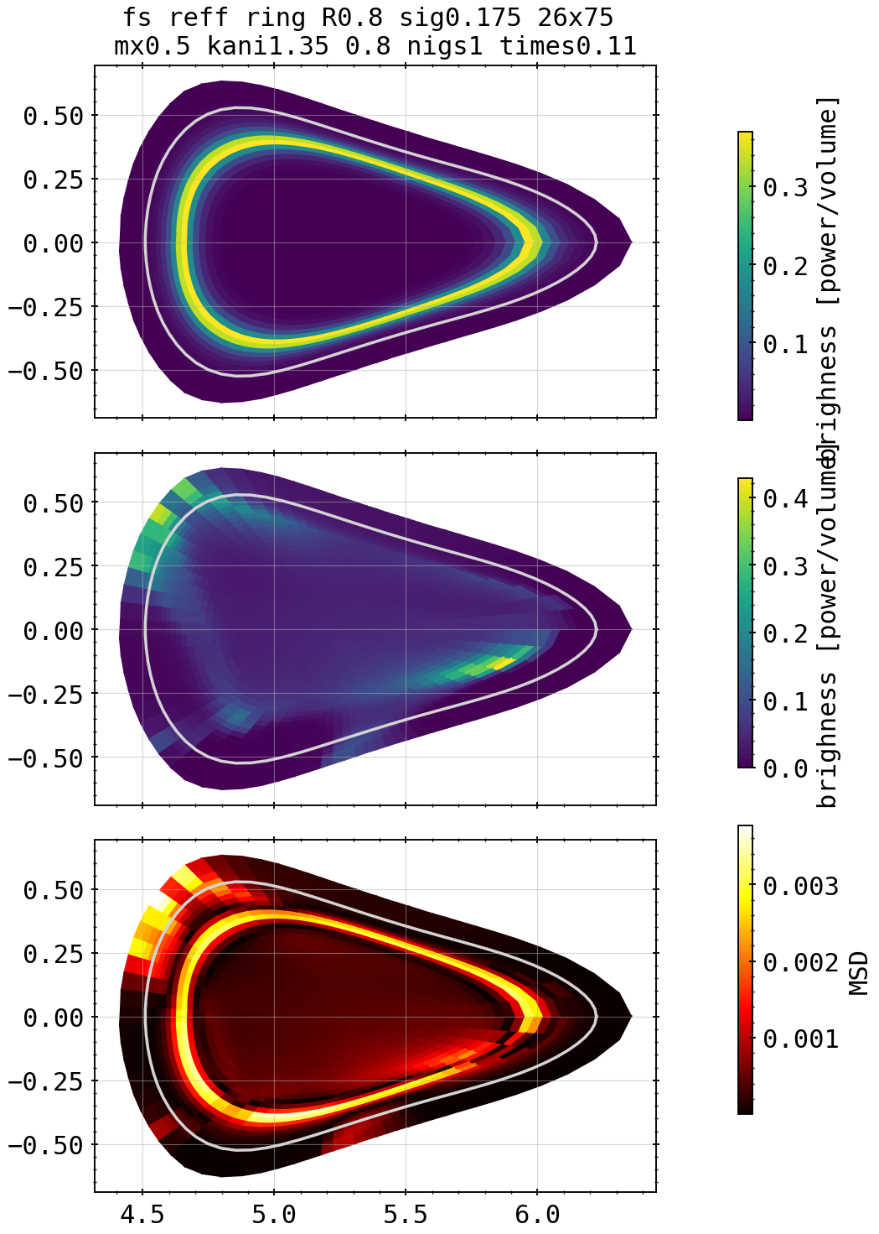
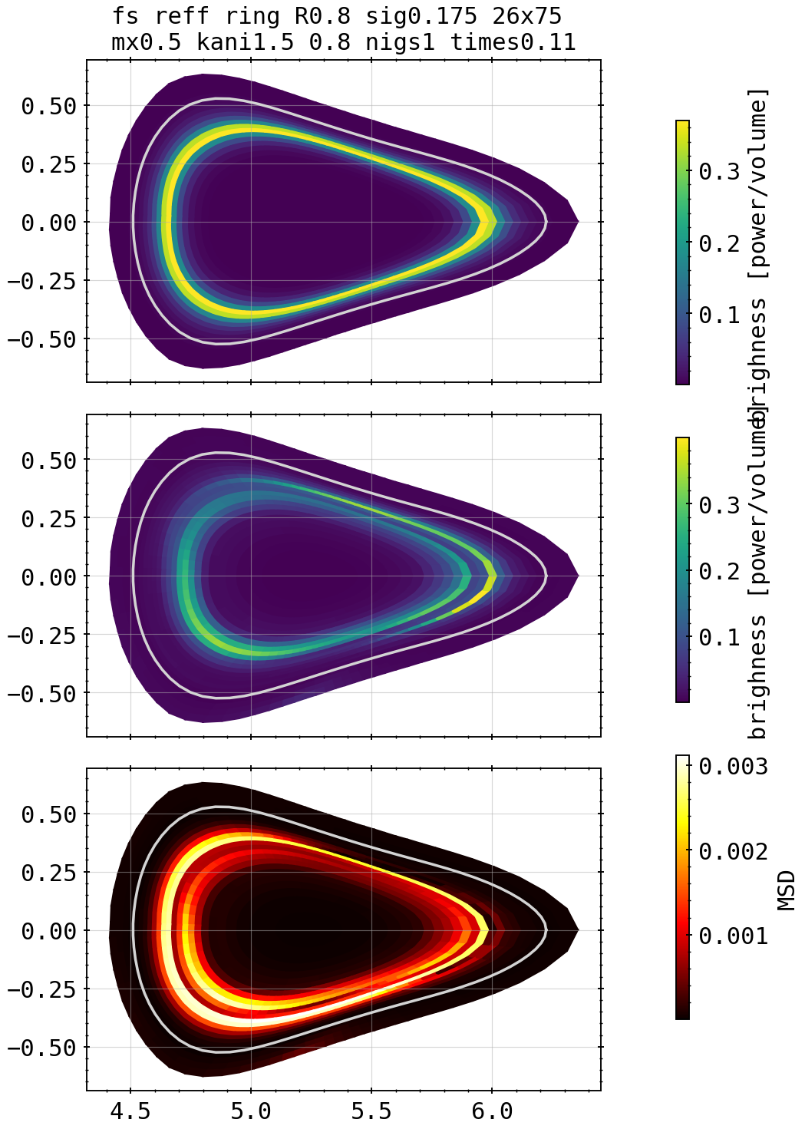
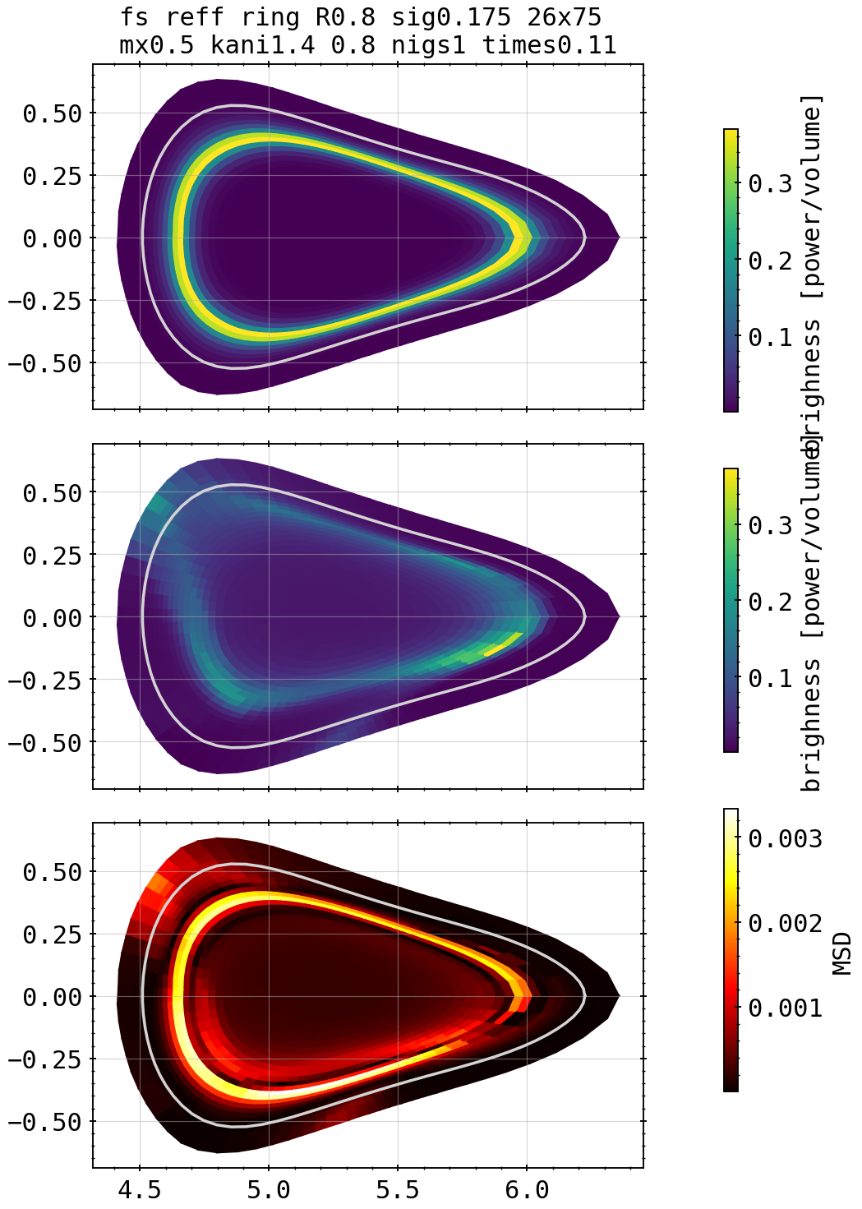




Phantoms: Ring inside LCFS Core Scan
1.35
1.5
X²=1.02
X²=1.01
Kcore=1.25, kdiff=0.8
1.4
1.55
X²=32.8
X²=1.0
X²=1.04
1.3
1.45
1.6
X²=1.84
X²=1.04
X²=1.21

Slide 20





Phantoms: Ring inside LCFS Core Scan
1.75
Kcore=1.5, kdiff=0.8
X²=8.03
1.65
1.8
X²=1.44
X²=20.56
1.7
X²=2.51

Slide 21







Phantoms: Ring outside LCFS Scan
Kcore=1.4, kdiff=0.8
Kcore=1.5, kdiff=0.6
X²=1.007
X²=1.012
Kcore=1.35, kdiff=0.8
Kcore=1.6, kdiff=0.8
X²=1.004
X²=1.012
Kcore=1.45, kdiff=0.8
Kcore=1.5, kdiff=0.55
X²=1.001
X²=1.038

Slide 22







Phantoms: Island Mimic outside LCFS Scan
Kcore=1.7, kdiff=0.8
Kcore=1.5, kdiff=1.0
X²=19.38
X²=1.01
Kcore=1.6, kdiff=0.8
Kcore=1.5, kdiff=0.55
X²=9.79
X²=6.98
Kcore=1.65, kdiff=0.8
Kcore=1.5, kdiff=0.6
X²=6.208
X²=6.16

Slide 23




Phantoms: Combinations

Slide 24




Phantoms: Combinations
X²=4.87
X²=5.56

Slide 25




Phantoms: Combinations

Slide 26



Revisited: Cartesian Test, No Anisotropic Weighting

Slide 27

Revisited: Cartesian Test, No Anisotropic Weighting

Slide 28


STRAHL Profiles and 20181010.032 Feedback Discharge
frad=33%
X²=94.85
X²=1.43

Slide 29


STRAHL Profiles and 20181010.032 Feedback Discharge
frad=66%
X²=2218
X²=1. 01

Slide 30


STRAHL Profiles and 20181010.032 Feedback Discharge
frad=90%
X²=2245
X²=1.05

Slide 31


STRAHL Profiles and 20181010.032 Feedback Discharge
frad=100%
X²=4705
X²=1.009

Slide 32













Revisited: Test of 20180725.044
KJM magnetic configuration
chordal profile HBCm

Slide 33

Revisited: Test of 20180725.044
KJM magnetic configuration
chordal profile HBCm

Slide 34
Revisited: Test of 20180725.044
KJM magnetic configuration
chordal profile HBCm

Slide 35
Revisited: Test of 20180725.044
KJM magnetic configuration
chordal profile HBCm

Slide 36
Revisited: Test of 20180725.044
KJM magnetic configuration
chordal profile HBCm

Slide 37
Revisited: Test of 20180725.044
KJM magnetic configuration
chordal profile HBCm

Slide 38
Revisited: Test of 20180725.044
KJM magnetic configuration
chordal profile HBCm

Slide 39
Revisited: Test of 20180725.044
KJM magnetic configuration
chordal profile HBCm

Slide 40
Revisited: Test of 20180725.044
KJM magnetic configuration
chordal profile HBCm

Slide 41
Revisited: Test of 20180725.044
KJM magnetic configuration
chordal profile HBCm

